Slide 1
Refinement of Workload Models for Engine Controllers by
State Space Partitioning
Morteza Mohaqeqi, Jakaria Abdullah,
Pontus Ekberg, and Wang Yi
Uppsala University, Sweden
Notes:
Refinement of Workload Models for Engine Controllers by State Space Partitioning

Slide 2


Slide 3
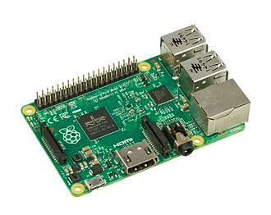
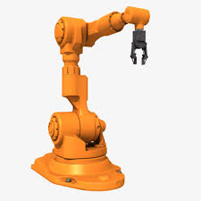
Introduction
Events
Physical system
Computational system
Current state
Control
Task activation pattern:
At apriori known instants, or
Upon arrival of a new event.
Notes:
I start with a big picture of a cyber-physical system.
In a CPS, the computer part monitors physical subsystem, performs some computations, and based on the current physical state,
appropriate control commands are generated and applied to the physical system.
This procedure can be done in two ways, namely time-triggered and event-triggered.
In the former case, the computational jobs are activated at apriori known time instants (we may call these jobs as time-triggered jobs).
For instance, this approach can be implemented in the form of periodic real-time tasks.
On the other hand, some jobs are activated whenever a new event is received from the physical subsystem.

Slide 4







Introduction
Events
Physical system
Computational system
Current state
Control
events
$$e_{1}$$
$$e_{2}$$
$$e_{3}$$
Arrival time
$$t_{1}$$
$$t_{2}$$
$$t_{3}$$
$$time$$
Notes:
What is the consequence of this dependence of tasks on external events?
The concern is that the release time of the jobs is not known in this case.
As a result, the inter-release time for the jobs is variable, which complicates timing analysis of the system..
In addition, since the computation is performed based on the current state of the physical system,
and as the physical system is a dynamic system, the type of the event and then, the type of computations is also variable.

Slide 5
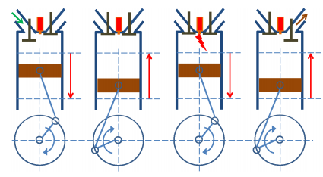






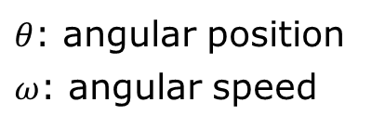

Engine Controllers
[Guo and Baruah, 2015]
Crankshaft position
A job is released at $θ=0, 2π, 4π, …$
$$ω$$
$$θ$$
$θ$: angular position
$ω$: angular speed
Jobs with variable inter-release time
$$ω(t)$$
$$time$$
$$0$$
$$2π$$
$$4π$$
$$t_{1}$$
$$t_{2}$$
$$t_{3}$$
Notes:
An example of these systems is the engine control application.
In this system, a job is supposed to be released whenever the crankshaft reaches a certain position (angle).
We denote
In this case, the inter-release time depends on the rotational speed of the crankshaft.
So, for workload characterization, we need to precisely know the behavior/evolution/movement of the physical system.

Slide 6









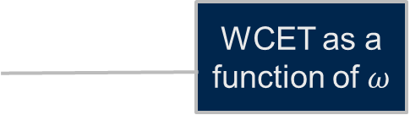

Engine Controllers
[Guo and Baruah, 2015]
Crankshaft position
Job type is determined by the angular speed ($ω$)
$$ω$$
$$θ$$
$θ$: angular position
$ω$: angular speed
$$C(ω)$$
$$C_{1}$$
WCET as a function of $ω$
$$C_{2}$$
$$C_{3}$$
$$ω$$
$$ω_{1}$$
$$ω_{2}$$
$$ω_{3}$$
$$ω_{4}$$
Notes:
In addition, the WCET of a job can be variable according to the current state of the (physical) system

Slide 7
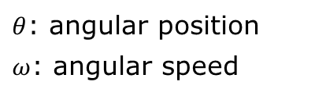
Engine Controllers
[Guo and Baruah, 2015]
Crankshaft position
$$ω$$
$$θ$$
$θ$: angular position
$ω$: angular speed
Both WCET and inter-release times
are variable (functions of system state)

Slide 8


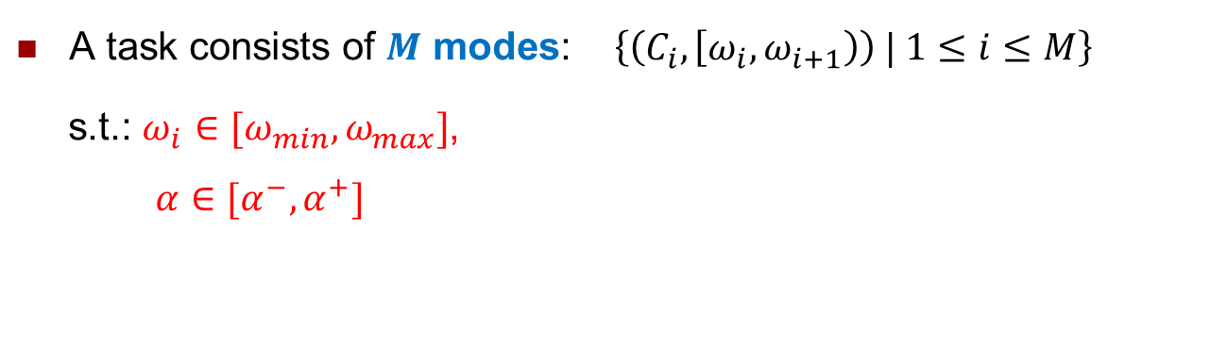
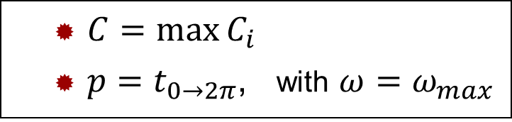
The Problem
A task consists of $M$ modes: $\left\{\left(C_{i},\left[ω_{i},ω_{i+1}\right)\right) | 1≤i≤M\right\}$
s.t.: $ω_{i}∈[ω_{min},ω_{max}]$,
$α∈[α^{−},α^{+}]$
WCET
Speed range
Input: A set of engine control tasks
Goal: Ensuring (timely) correct behavior of the system
Sporadic Task Model?
Pessimistic !
  $C=\max{C_{i}}$
  $p=t_{0→2π}$, with $ω=ω_{max}$
Notes:
To be a little bit more formal, an engine control task is specified as a set of modes …

Slide 9
The Problem
A task consists of $M$ modes: $\left\{\left(C_{i},\left[ω_{i},ω_{i+1}\right)\right) | 1≤i≤M\right\}$
s.t.: $ω_{i}∈[ω_{min},ω_{max}]$,
$α∈[α^{−},α^{+}]$
WCET
Speed range
Input: A set of engine control tasks
Goal: Ensuring (timely) correct behavior of the system
Sporadic tasks?
Pessimistic !
  $C=\max{C_{i}}$
  $p=t_{0→2π}$, with $ω=ω_{max}$
Notes:
To be a little bit more formal, an engine control task is specified as a set of modes …

Slide 10
The Problem
Input: A set of engine control tasks
Workload characterization
Timing analysis
Goal: Ensuring (timely) correct behavior of the system
Model (Task Set)
Notes:
To address this problem, two steps should be done:
1. Precisely characterizing the generated workload using appropriate models (by appropriate, I mean models which are capable of expressing all required information of the tasks),
2. Timing analysis of the workload models.

Slide 11
The Problem
Input: A set of engine control tasks
Workload characterization
Timing analysis
Goal: Ensuring (timely) correct behavior of the system
Model (Task Set)
This talk
Using existing methods
Notes:
To address this problem, two steps should be done:
1. Precisely characterizing the generated workload using appropriate models (by appropriate, I mean models which are capable of expressing all required information of the tasks),
2. Timing analysis of the workload models.

Slide 12

Solution Steps

Slide 13












Problem 1: Which Task Model?
Observation 1: Different job types
Observation 2: Variable inter-release time
$$p_{1}$$
$$p_{2}$$
$$p_{4}$$
$$C_{1}$$
$$v_{1}$$
$$v_{2}$$
$$C_{2}$$
$$p_{5}$$
$$p_{3}$$
The Digraph Real-Time
(DRT) task model
$$v_{3}$$
$$C_{3}$$
Notes:
We are not the first who employs the DRT task model for modeling a set of engine control tasks.
However, our method is more accurate compared to the previous ones.
More precisely, the previous methods are either pessimistic or optimistic
in calculating the real-time task parameters.

Slide 14
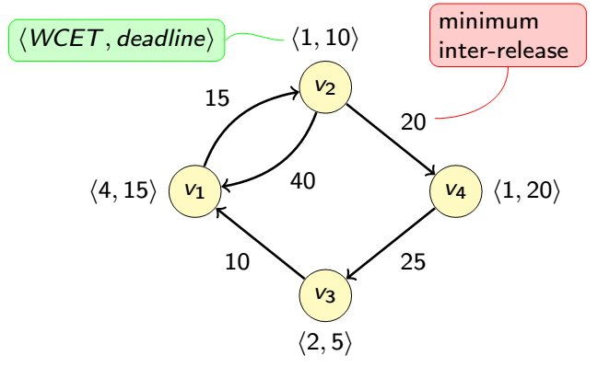
The DRT Task Model
Digraph Real-Time (DRT) Tasks [Stigge et al. 2011]
DRT is used for Engine Controllers in previous work, but …

Slide 15










Problem 2: Model Construction
Computing the model parameters
  Inter-release times
$$p_{1}$$
$$p_{4}$$
$$p_{2}$$
$$v_{1}$$
$$v_{2}$$
$$p_{3}$$
$$[ω_{1},ω_{2})$$
$$[ω_{2},ω_{3})$$
$$v_{3}$$
$$[ω_{3},ω_{4})$$
Notes:
The next problem is that how many vertexes the graph should have,
And also once the number of vertexes is determined, how the graph parameters, namely WCETs and inter-release times can be calculated

Slide 16



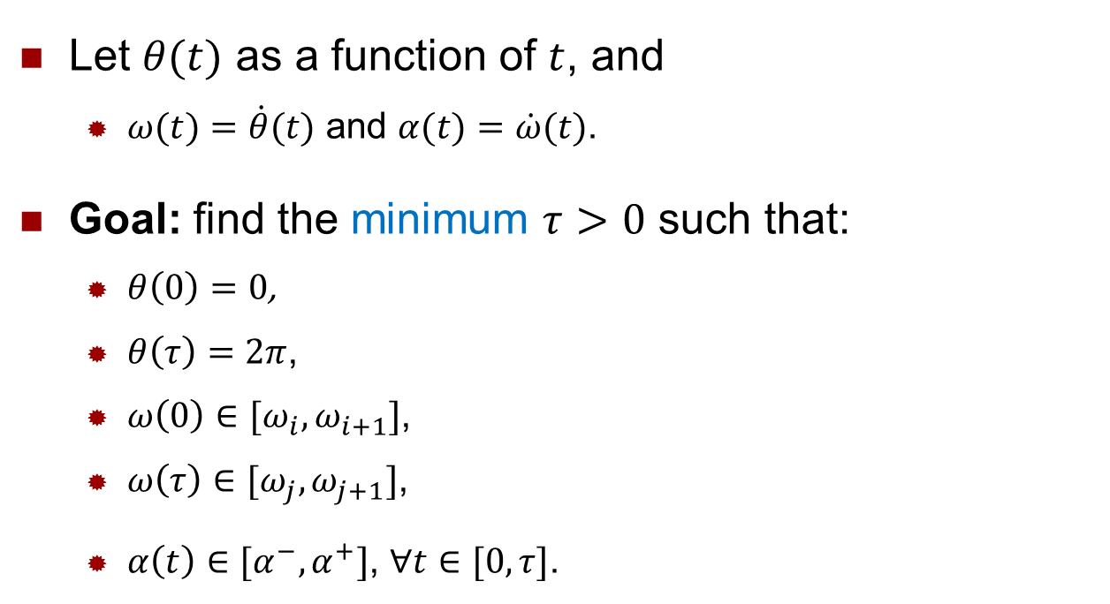


Problem Formulation
$$p$$
$$v_{i}$$
$$v_{j}$$
$$[ω_{i},ω_{i+1})$$
$$[ω_{j},ω_{j+1})$$
Let $θ(t)$ as a function of $t$, and
  $ω(t)=\dot{θ}(t)$ and $α(t)=\dot{ω}(t)$.
Goal: find the minimum $τ>0$ such that:
  $θ\left(0\right)=0$,
  $θ\left(τ\right)=2π$,
  $ω\left(0\right)∈[ω_{i},ω_{i+1}]$,
  $ω\left(τ\right)∈[ω_{j},ω_{j+1}]$,
  $α\left(t\right)∈[α^{−},α^{+}]$, $∀t∈[0,τ]$.
Boundary conditions
System constraint

Slide 17
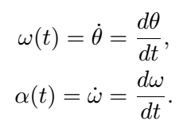

















A Visual Representation
$$θ(t)$$
$$2π$$
$$0$$
$$τ$$
$$t$$
$$ω(t)$$
Boundary conditions
(initial and final states)
$$ω_{j+1}$$
$$ω_{j}$$
$$ω_{i+1}$$
$$ω_{i}$$
$$0$$
$$τ$$
$$t$$
$$α(t)$$
$$α^{+}$$
A feasible solution
$$t$$
$$α^{−}$$
System constraint

Slide 18


Solution
From optimal control theory:
The minimum-time problem: To find the best
possible control to take a dynamical system from
one state to another.
Solution: The Pontryagin’s minimum principle
Notes:
Lev Semenovich Pontryagin
http://www-history.mcs.st-andrews.ac.uk/Biographies/Pontryagin.html

Slide 19
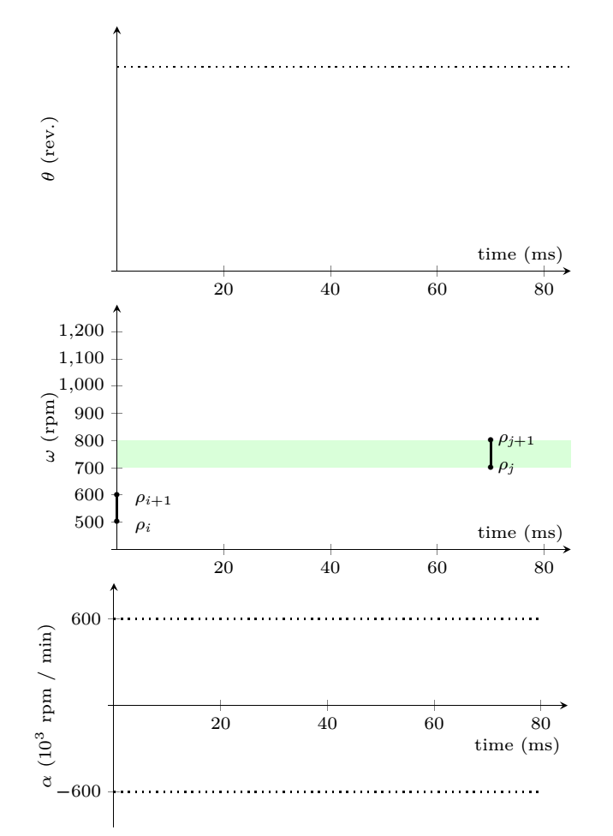


Illustration
$$2π$$
$$2π$$
Notes:
Z. Guo and S.K. Baruah. Uniprocessor EDF scheduling of AVR task systems. In International Conference on Cyber-Physical Systems (ICCPS), pages 159–168. ACM, 2015.
Biondi, G. Buttazzo, and S. Simoncelli. Feasibility analysis of engine control tasks under edf scheduling. In Euromicro Conference on Real-Time Systems (ECRTS), pages 139–148, July 2015.
By using this Principle, it is shown that model is safe, i.e., it covers the worst-case that can happen with respect to minimum inter release times.

Slide 20
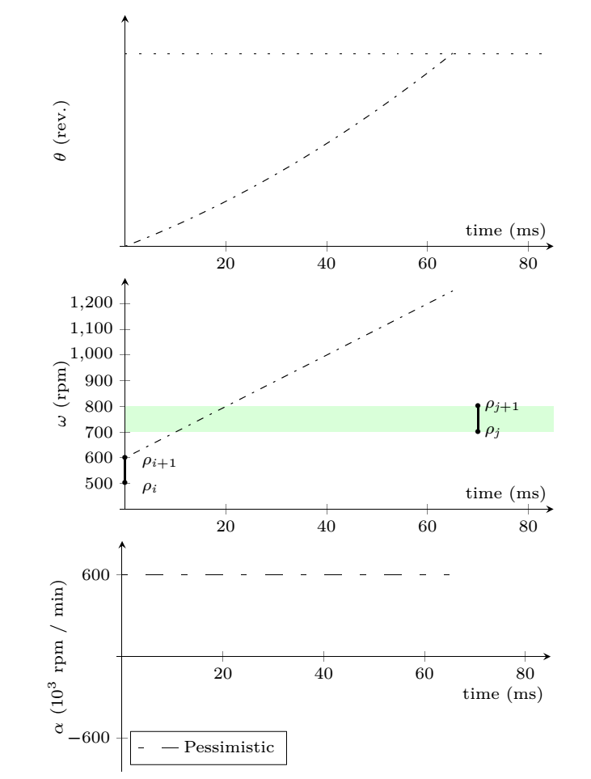
Optimal vs. pessimistic * vs. optimistic ** approaches
$$2π$$
* Guo and Baruah, ICCPS 2015.
** Biondi et al., ECRTS 2015.
Notes:
Z. Guo and S.K. Baruah. Uniprocessor EDF scheduling of AVR task systems. In International Conference on Cyber-Physical Systems (ICCPS), pages 159–168. ACM, 2015.
Biondi, G. Buttazzo, and S. Simoncelli. Feasibility analysis of engine control tasks under edf scheduling. In Euromicro Conference on Real-Time Systems (ECRTS), pages 139–148, July 2015.
By using this Principle, it is shown that model is safe, i.e., it covers the worst-case that can happen with respect to minimum inter release times.

Slide 21
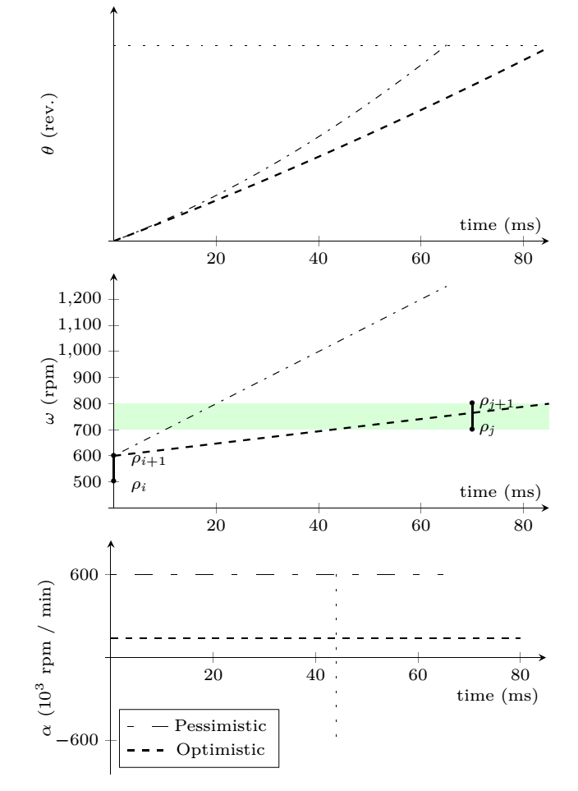
Optimal vs. pessimistic * vs. optimistic ** approaches
$$2π$$
* Guo and Baruah, ICCPS 2015.
** Biondi et al., ECRTS 2015.
Notes:
Z. Guo and S.K. Baruah. Uniprocessor EDF scheduling of AVR task systems. In International Conference on Cyber-Physical Systems (ICCPS), pages 159–168. ACM, 2015.
Biondi, G. Buttazzo, and S. Simoncelli. Feasibility analysis of engine control tasks under edf scheduling. In Euromicro Conference on Real-Time Systems (ECRTS), pages 139–148, July 2015.
By using this Principle, it is shown that model is safe, i.e., it covers the worst-case that can happen with respect to minimum inter release times.

Slide 22
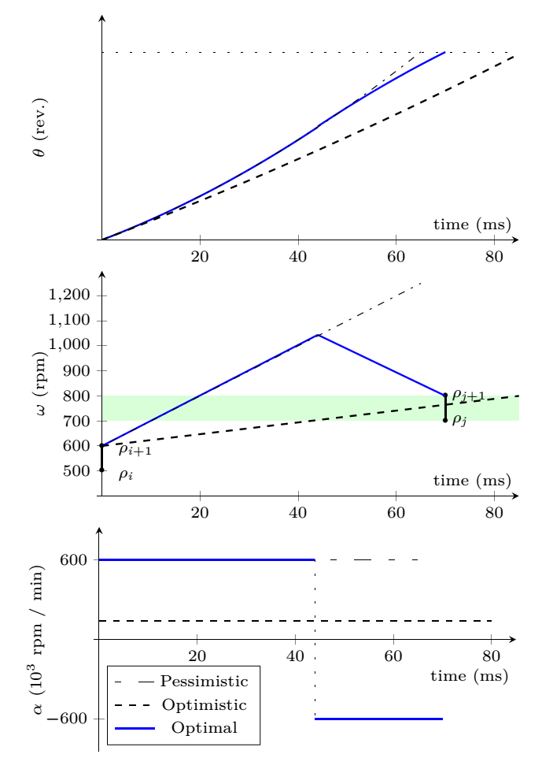
Optimal vs. pessimistic * vs. optimistic ** approaches
$$2π$$
* Guo and Baruah, ICCPS 2015.
** Biondi et al., ECRTS 2015.
Notes:
Z. Guo and S.K. Baruah. Uniprocessor EDF scheduling of AVR task systems. In International Conference on Cyber-Physical Systems (ICCPS), pages 159–168. ACM, 2015.
Biondi, G. Buttazzo, and S. Simoncelli. Feasibility analysis of engine control tasks under edf scheduling. In Euromicro Conference on Real-Time Systems (ECRTS), pages 139–148, July 2015.
By using this Principle, it is shown that model is safe, i.e., it covers the worst-case that can happen with respect to minimum inter release times.

Slide 23
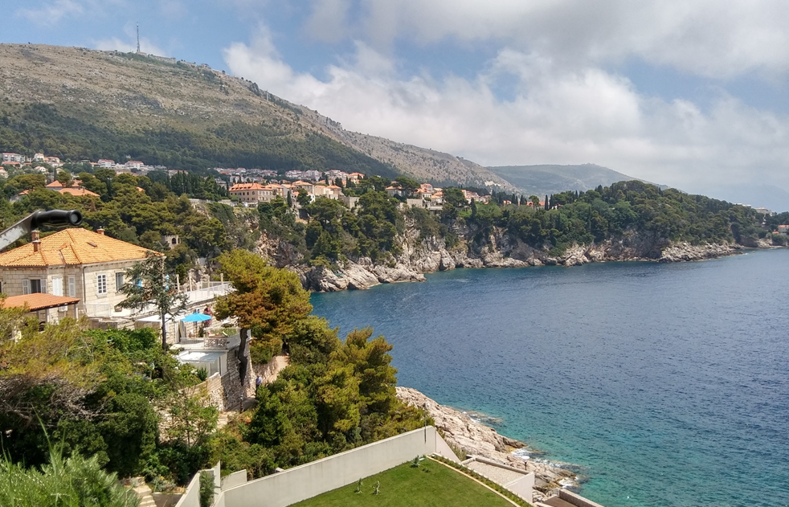
Dubrovnik, June 27, 2017
Notes:
The time to see a nice picute!

Slide 24














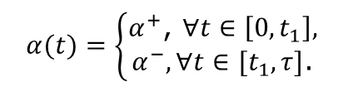


Solution for Different Cases
Speed ranges
Optimal solution
1:
$$ω_{f,2}$$
$$ω_{f,1}$$
No feasible solution
$${α\left(t\right)=α}^{+}$$
$$ω_{i,2}$$
$$ω_{i,1}$$
2:
$$ω_{f,2}$$
$$ω\left(0\right)=ω_{i,2}, α\left(t\right)=α^{+},∀t∈[0,τ]$$
$$ω_{f,1}$$
$$ω_{i,2}$$
$$ω_{i,1}$$
3:
$$ω_{f,2}$$
$$α(t)=\left\{\begin{aligned}α^{+}\text{, }∀t∈\left[0,t_{1}\right], \\ α^{−},∀t∈[t_{1},τ]\text{.}\end{aligned}\right.$$
$$ω_{i,2}$$
$ω\left(0\right)=ω_{i,2}$,
$$ω_{f,1}$$
$$ω_{i,1}$$
$$time$$
$$0$$
$$t_{1}$$
$$τ$$

Slide 25






Problem 2: Model Construction
Recognizing appropriate job types
(partitioning the speed interval)
$$[ρ_{1},ρ_{2})$$
$$v_{1}$$
$$v_{2}$$
$$[ρ_{2},ρ_{3})$$
$$v_{3}$$
$$[ρ_{3},ρ_{4})$$
Notes:
We first tackle the latter problem

Slide 26
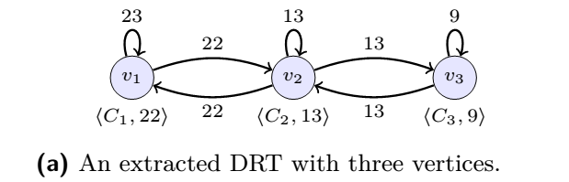





Speed Range Partitioning
$$ω_{min}$$
$$ω_{max}$$
$$v_{1}$$
$$v_{2}$$
$$v_{3}$$
speed (rpm)
500
2500
4500
6500

Slide 27
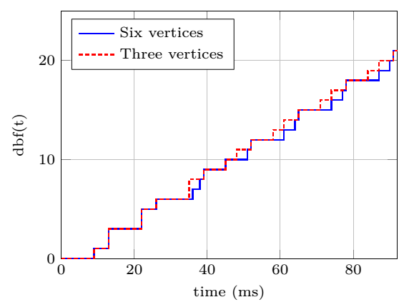
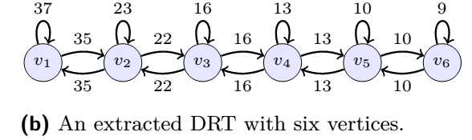






Speed Range Partitioning
$$ω_{min}$$
$$ω_{max}$$
$$v_{1}$$
$$v_{2}$$
$$v_{3}$$
$$v_{4}$$
$$v_{5}$$
$$v_{6}$$
speed (rpm)
500
2500
4500
6500
Notes:
It is seen that by refining the model (obtaning more fine-grained model), more accurate analysis is obtained.
The question is that how to partition such that the analysis is tight (it contains no pessimism).
Whould we uniformly partition? NO!

Slide 28








Speed Range Partitioning: Idea
A sufficient condition for the speed partitioning to lead to a tight DRT model.
$$ω_{min}$$
$$ω_{max}$$
$$…$$
$$v_{i}$$
$$v_{j}$$
$$…$$
speed (rpm)
500
$$Δθ=2π$$
$$α=α^{+}$$
6500
$$Δθ=2π$$
$$α=α^{−}$$
Notes:
By a tight model, we mean a DRT task model which provides a exact timing analysis, namely neither pessimistic, nor optimistic
We have proved that this condition is sufficient for a tight analysis

Slide 29
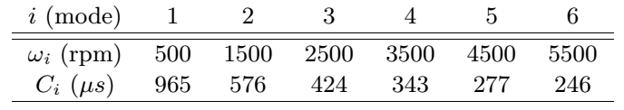
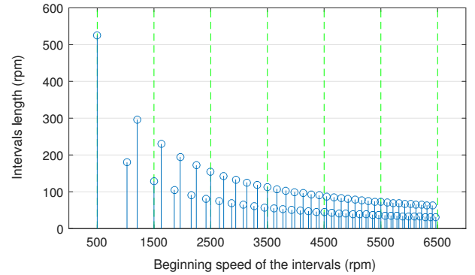
Speed Range Partitioning: Result
Task parameters are from [Biondi et al., ECRTS, 2014]

Slide 30

Evaluation

Slide 31
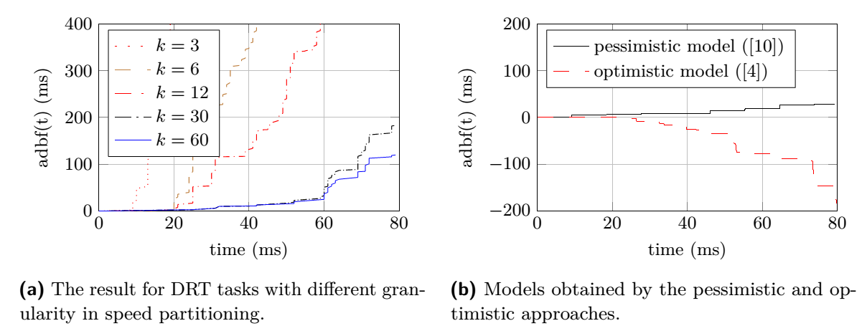

Analysis efficiency
Computing dbf for $t∈\left[0,80000\right]μs$:

Slide 32
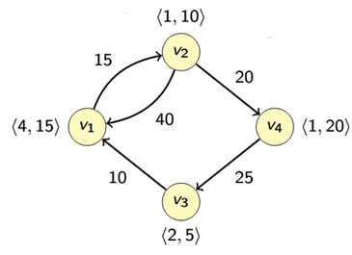
Conclusion
Physical system
Computational system
Abstraction
Yet tight
DRT Tasks
Notes:
What is the consequence of this dependence of tasks on external events?
The concern is that the release time of the jobs is not known in this case.
As a result, the inter-release time for the jobs is variable, which complicates timing analysis of the system..
In addition, since the computation is performed based on the current state of the physical system,
and as the physical system is a dynamic system, the type of the event and then, the type of computations is also variable.

Slide 33
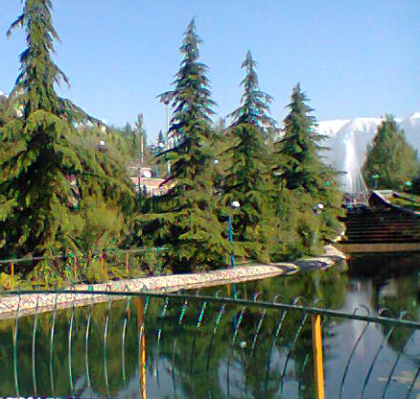

Refinement of Workload Models for Engine Controllers by State Space Partitioning
Thanks!
morteza.mohaqeqi@it.uu.se

Slide 34

Backup Slides

Slide 35




Demand-bound function (dbf)
where:
Feasibility condition:

Slide 36
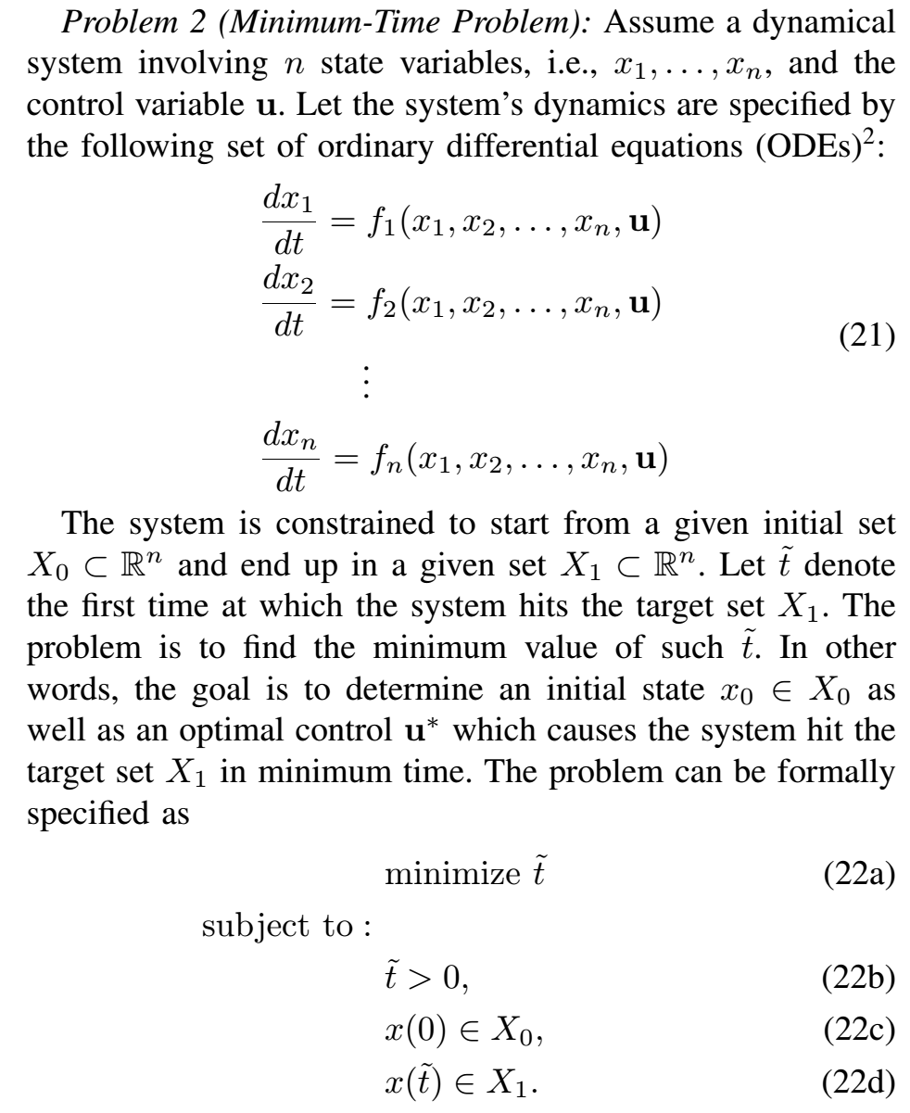
Minimum-time problem

Slide 37
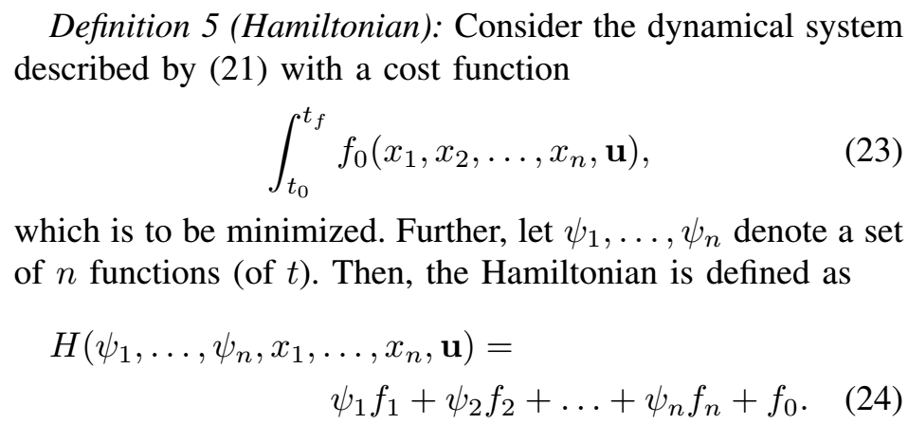
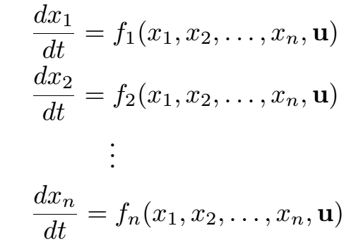
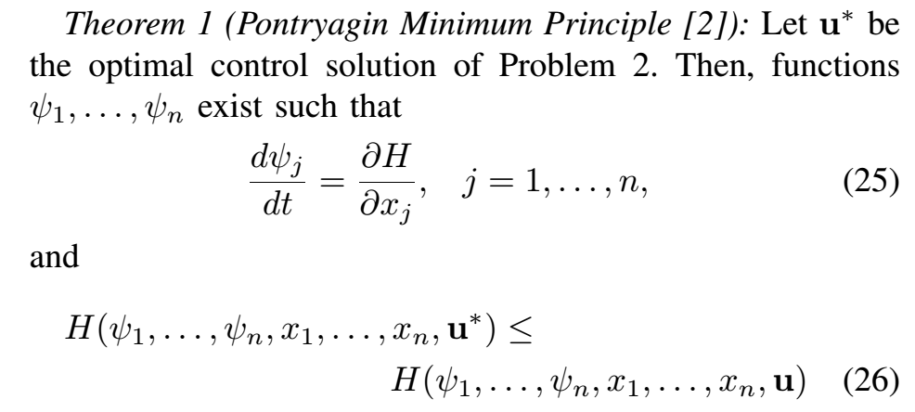
Pontryagin Minimum Principle

Slide 38
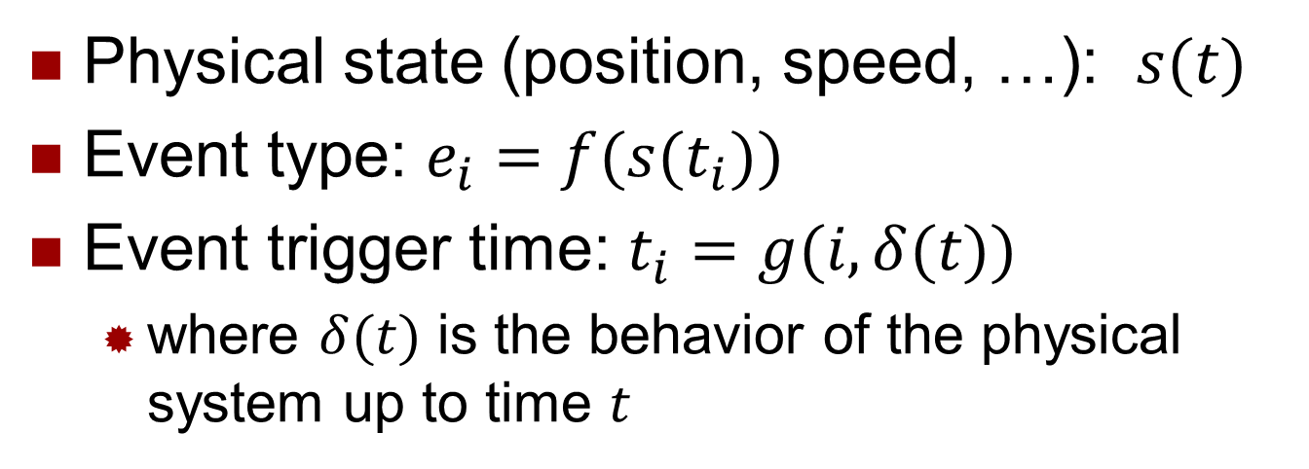




Introduction
$$e_{i}$$
$$e_{i}$$
$$t_{i}$$
$$time$$
Physical System
Computational System
Physical state (position, speed, …): $s(t)$
Event type: $e_{i}=f(s(t_{i}))$
Event trigger time: $t_{i}=g(i,δ(t))$
  where $δ(t)$ is the behavior of the physical system up to time $t$
Notes:
The result of this process is a sequence of events that are sent to the computational part.

Slide 39
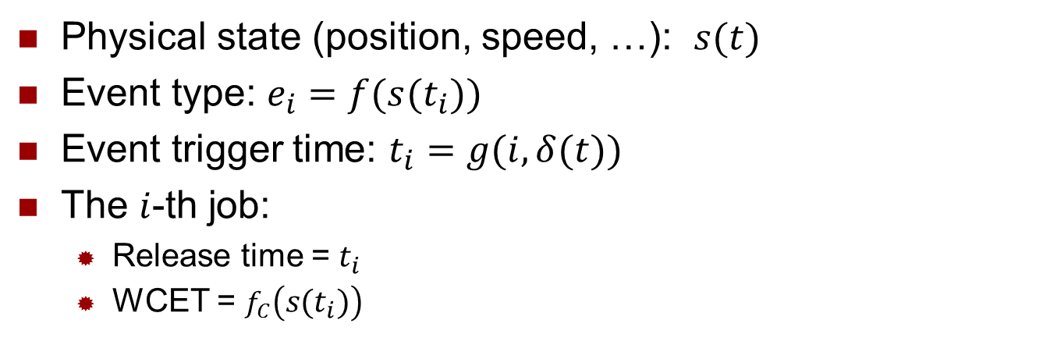
Introduction
$$e_{i}$$
$$e_{i}$$
$$t_{i}$$
$$time$$
Physical System
Computational System
Physical state (position, speed, …): $s(t)$
Event type: $e_{i}=f(s(t_{i}))$
Event trigger time: $t_{i}=g(i,δ(t))$
The $i$-th job:
  Release time = $t_{i}$
  WCET = $f_{C}\left(s\left(t_{i}\right)\right)$

Slide 40

Number of partitions$=O(M×\frac{ω_{max}^{2}−ω_{min}^{2}}{2α^{+}})$

Slide 41

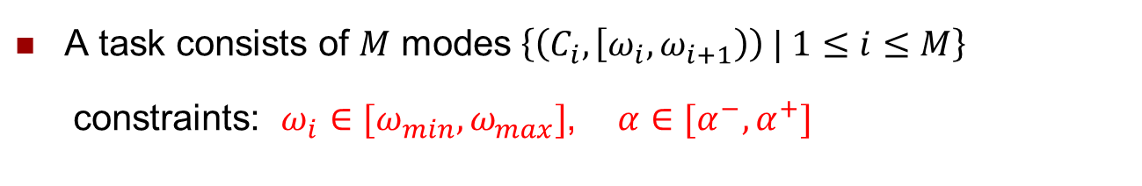
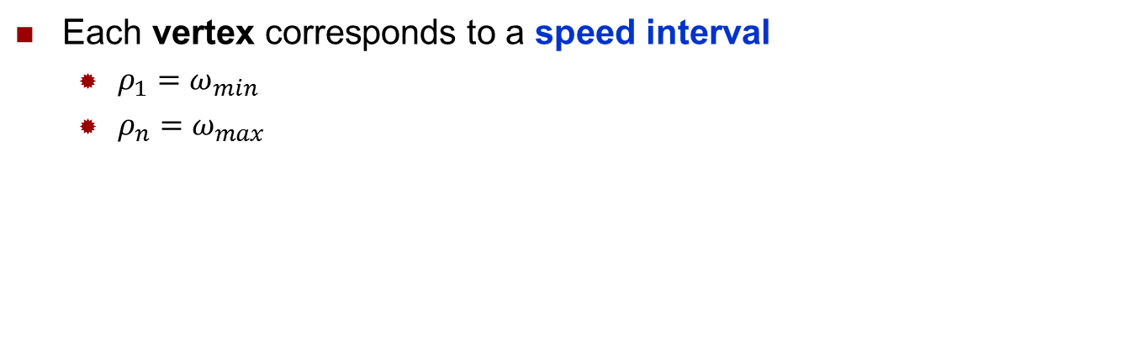








Problem 2: Model Construction
A task consists of $M$ modes $\left\{\left(C_{i},\left[ω_{i},ω_{i+1}\right)\right) | 1≤i≤M\right\}$
constraints: $ω_{i}∈[ω_{min},ω_{max}]$, $α∈[α^{−},α^{+}]$
$$p_{1}$$
$$p_{2}$$
$$[ρ_{1},ρ_{2})$$
$$v_{1}$$
$$v_{2}$$
$$[ρ_{2},ρ_{3})$$
$$p_{3}$$
Each vertex corresponds to a speed interval
  $ρ_{1}=ω_{min}$
  $ρ_{n}=ω_{max}$
$$v_{3}$$
$$[ρ_{3},ρ_{4})$$
Notes:
The next problem is that how many vertexes the graph should have,
And also once the number of vertexes is determined, how the graph parameters, namely WCETs and inter-release times can be calculated

Slide 42
Problem 2: Model Construction
2.1. Recognizing appropriate job types (partitioning speed interval)
2.2. Calculating the model parameters
  WCET
  Inter-release times
Notes:
We first tackle the latter problem

Slide 43
The Problem
Unfortunately, in cyber-physical systems, a job may be released whenever a new event is arrived, whose instant is perhaps not known ☹.
But, jobs arrive according to the physical system state whose behavior is subject to known mathematical models (physical law) ☺
As a result, to determine the release pattern of the jobs, we need to know the physical system behavior.

