Slide 1
Sub-pJ per Operation
Scalable Computing with the PULP Platform
MCC2017, Uppsala
30.11.2017
Davide Rossi,
davide.rossi@unibo.it
Notes:
Traver is not with us any more

Slide 2
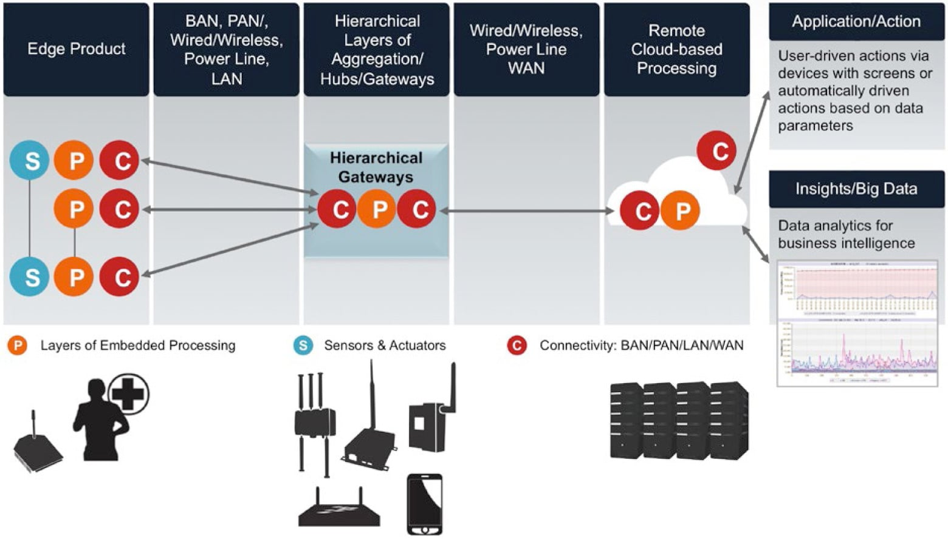
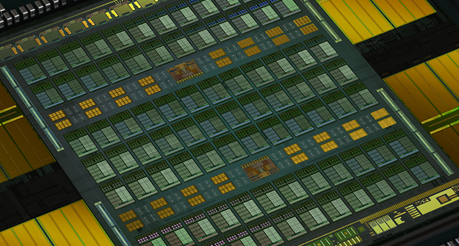
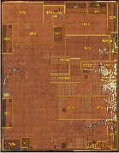
CPS/IoT Hierarchical Processing
Apple A11 90mm2 TSMC10nm
NVIDIA V100 815mm2 TSMC12nm

Slide 3

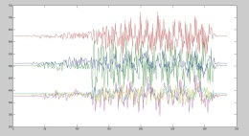

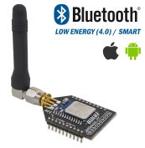


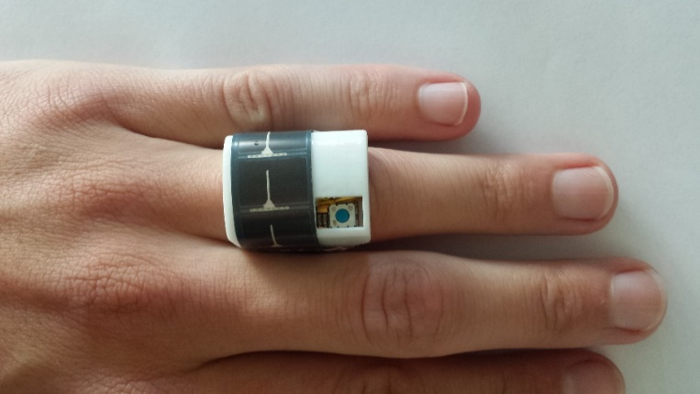
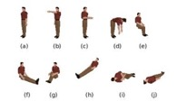
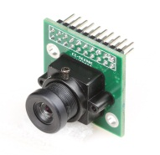

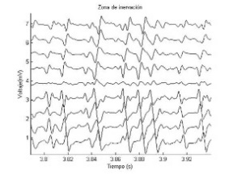

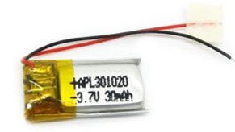

Near Sensor (aka Edge) Processing
Sense
Analyze and Classify
Transmit
MEMS IMU
µController
Short range, medium BW
L2 Memory
MEMS Microphone
ULP
Parallel Processor
e.g. CortexM
ULP Imager
Low rate (periodic) data
IOs
1 ÷ 2000 MOPS
1 ÷ 10 mW
SW update, commands
EMG/ECG/EIT
1 ÷ 25 MOPS
1 ÷ 10 mW
1 ÷ 25 MOPS
1 ÷ 10 mW
Long range, low BW
100 µW ÷ 2 mW
Idle: ~1µW
Active: ~ 50mW
Battery + Harvesting powered
→ a few mW power envelope

Slide 4
NSP: A Quantitative View
INPUT
BANDWIDTH
COMPUTATIONAL
DEMAND
OUTPUT
BANDWIDTH
COMPRESSION
FACTOR
Image
Voice/Sound
Inertial
Biometrics
Recognition:
607 Kbps
4.00 GOPS
10 bps
60700x
[*Ioffe2015]
INCEPTION CNN
Speech:
256 Kbps
100 MOPS
0.02 Kbps
12800x
[*VoiceControl]
Kalman:
2.4 Kbps
7.7 MOPS
0.02 Kbps
120x
[*Nilsson2014]
SVM:
16 Kbps
150 MOPS
0.08 Kbps
200x
[*Benatti2014]
Extremely compact output (single index, alarm, signature)
Parallel worlkoad

Slide 5
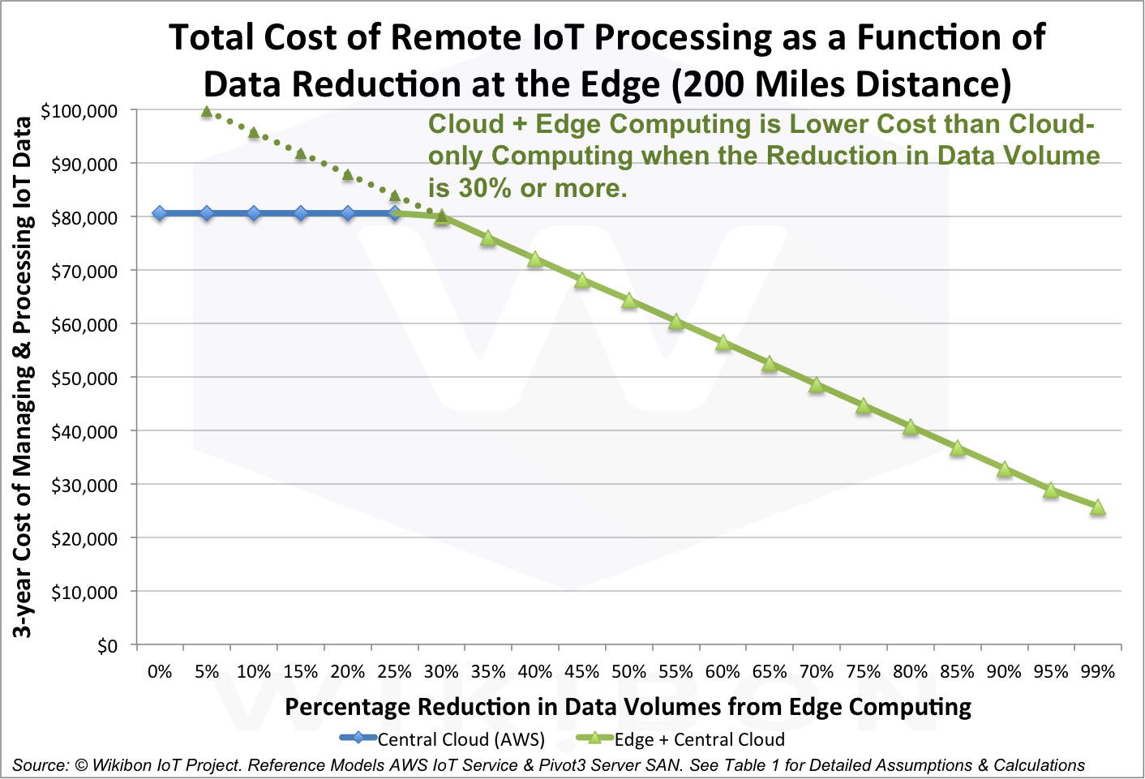

Does it Matter?
3x Cost reduction if data volume is reduced by 95%

Slide 6
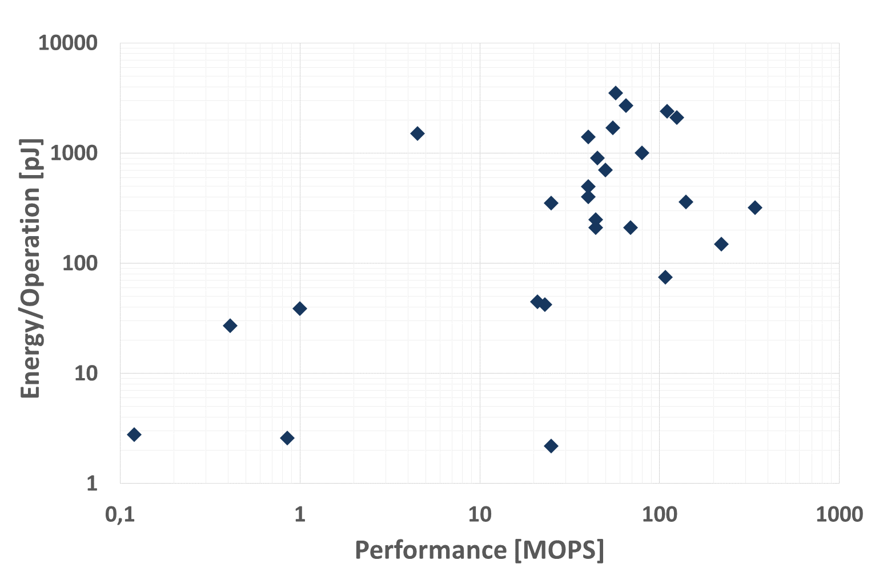
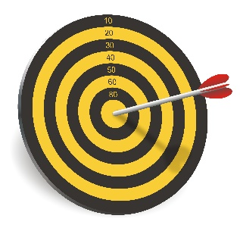
NSP on MCUs?
Courtesy of J Pineda, NXP + Updates
High performance MCUs
Low-Power MCUs
1pJ/OP → InceptionV3 @2fps in 10mW
100x

Slide 7
Parallel Ultra-Low Power

Slide 8
Outline
Near Threshold Multiprocessing
Non-Von Neumann Accelerators
Aggressive Approximation
From Frame-based to Event-based Processing
Outlook and Conclusion

Slide 9
Minimum Energy Operation
Source: Vivek De, INTEL – Date 2013
Near-Threshold Computing (NTC):
Don’t waste energy pushing devices in strong inversion
Recover performance with parallel execution
Manage process/temperature variations in NT!!!

Slide 10
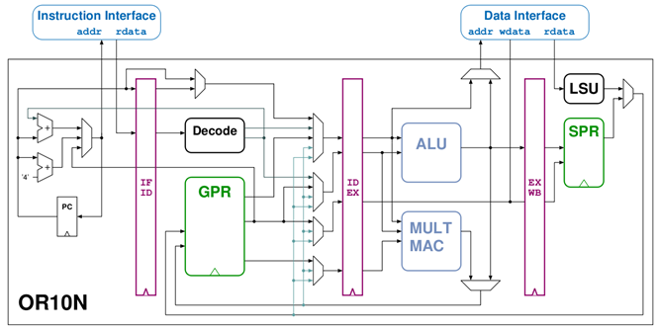

Near-Threshold Multiprocessing
4-stage OpenRISC &
RISC-V RV32IMC
I$B₀
I$B_{k}
PE₀
. . . . .
PE_{N-1}
N Cores
DEMUX
Periph
+ExtM
L1 TCDM+T&S
DMA + HW SYNCH
MB₀
MB_{M}
Tightly Coupled DMA
And Hardware Sychronizer
Shared L1 DataMem + Atomic Variables
1.. 8 PE-per-cluster, 1…32 clusters
NT but parallel → Max. Energy efficiency when Active
+ strong PM for (partial) idleness
D. Rossi et al., "Energy-Efficient Near-Threshold Parallel Computing: The PULPv2 Cluster," in IEEE Micro, Sep./Oct. 2017.

Slide 11
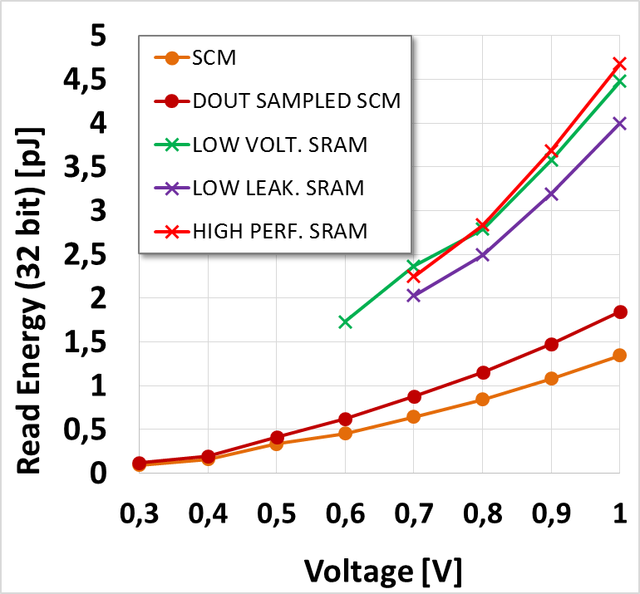
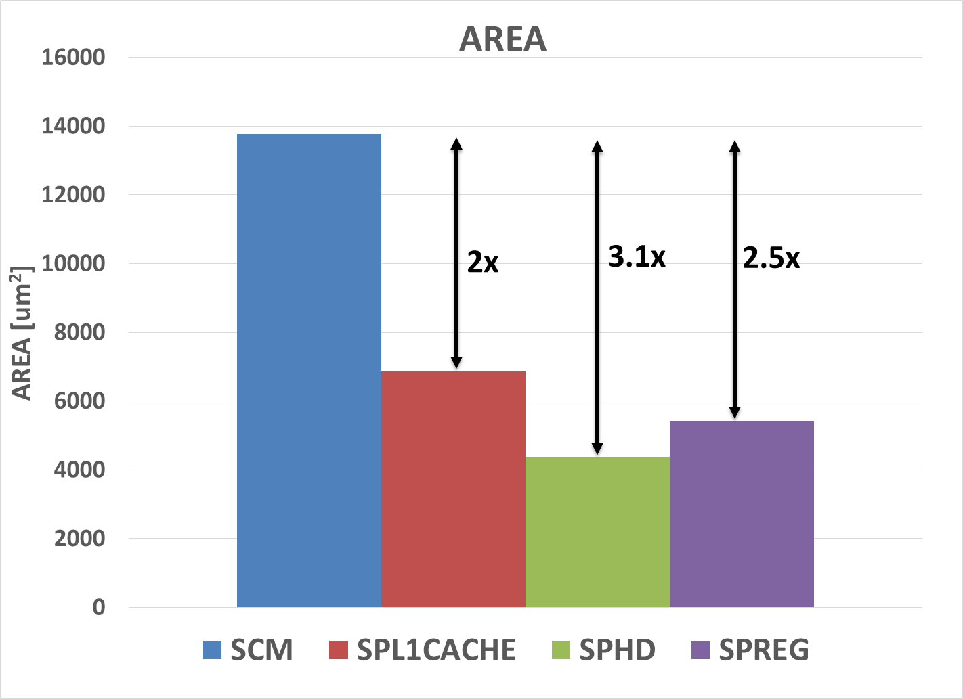
ULP (NT) Bottleneck: Memory
“Standard” 6T SRAMs:
  High VDDMIN
  Bottleneck for energy efficiency
    >50% of energy can go here!!!
Near-Threshold SRAMs (8T)
  Lower VDDMIN
  Area/timing overhead (25%-50%)
  High active energy
  Low technology portability
Standard Cell Memories:
  Wide supply voltage range
  Lower read/write energy (2x - 4x)
  High technology portability
  Major area overhead 4x → 2.7x with controlled placement
256x32 6T SRAMS vs. SCM
2x-4x
A. Teman et.al., ‘Power, Area, and Performance Optimization of Standard Cell Memory Arrays Through Controlled Placement’,
in ACM TDAES, May 2016

Slide 12
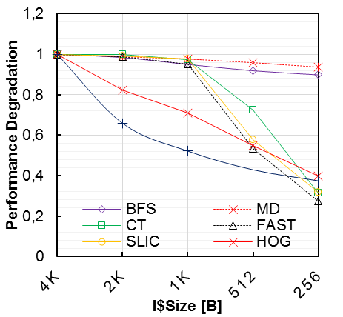
I$: a Look Into ‘Real Life’ Applications
SCM-BASED I$ IMPROVES EFFICIENCY BY ~2X ON SMALL BENCHMARKS, BUT…
Applications on PULP
Survey of State of The Art
Exixting ULP processors | Latch based I$
REISC (ESSCIRC2011) | 64b
Sleepwalker (ISSCC 2012) | 128b
Bellevue (ISCAS 2014) | 128b
SHORT JUMP LOOP
BASED APPLICATIONS
LONG JUMP APPLICATIONS
LIBRARY BASED
Issues:
Area Overhead of SCMs (4Kb/core not affordable….)
Capacity miss (with small caches)
Jumps due to runtime (e.g. OpenMP, OpenCL) and other function calls

Slide 13
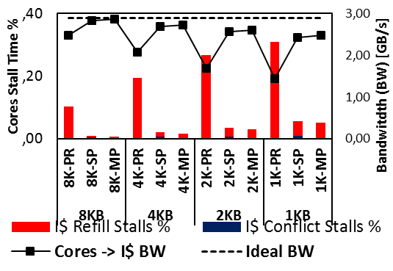
Shared I$
Share instruction cache
  OK for data parallel execution model
  Not OK for task parallel execution model, or very divergent parallel threads
Architectures
  SP: single-port banks connected through a read-only interconnect
    Pros: Low area overhead
    Cons: Timing pressure, contention
  MP: Multi-ported banks
    Pros: High efficiency
    Cons: Area overhead (several ports)
Results
  Up to 40% better performance than private I$
  Up to 30% better energy efficiency
  Up to 20% better energy*area efficiency
I. Loi, et.al., "The Quest for Energy-Efficient I$ Design in Ultra-Low-Power Clustered Many-Cores," in IEEE Transactions on Multi-Scale Computing Systems, In Press.

Slide 14
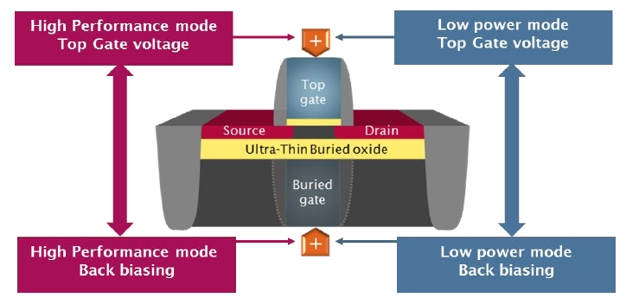





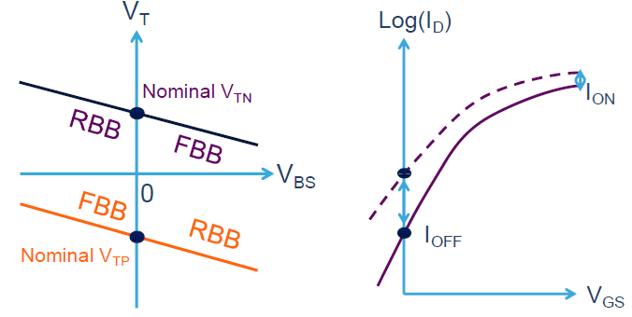
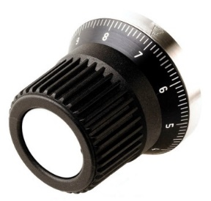
Near threshold FDSOI technology
Body bias: Highly effective knob for power & variability management!

Slide 15
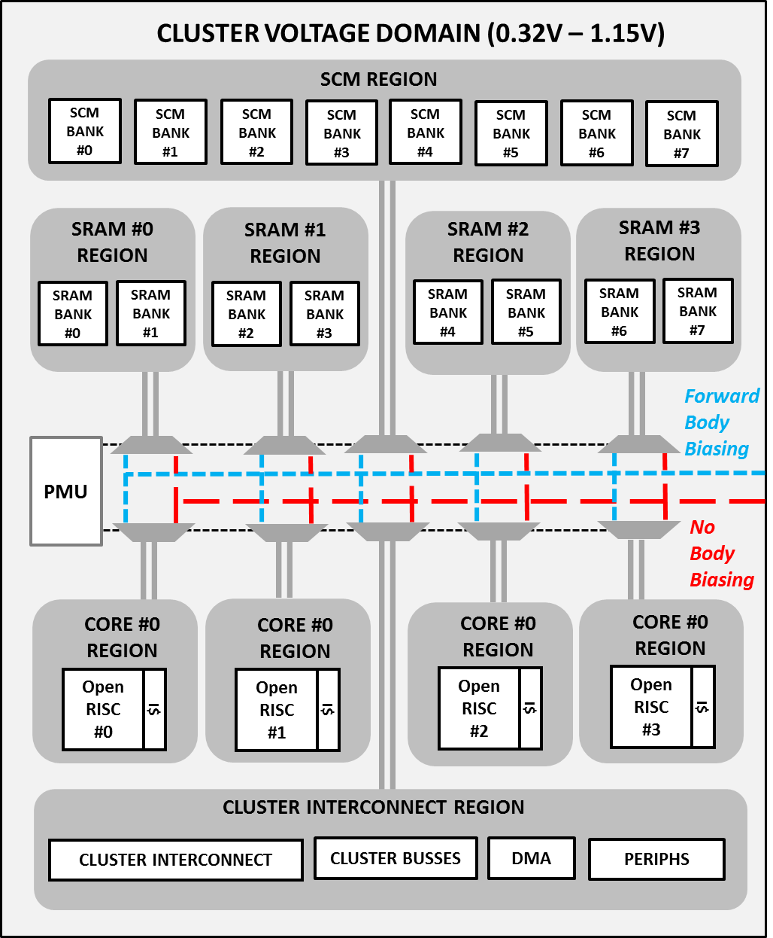
Selective, Fine Grained Body Biasing
The cluster is partitioned in separate clock gating and body bias regions
Body bias multiplexers (BBMUXes) control the well voltages of each region
A Power Management Unit (PMU) automatically manages transitions between the operating modes
Power modes of each region:
  Boost mode: active + FBB
  Normal mode: active + NO BB
  Idle mode: clock gated + NO BB (in LVT) RBB (in RVT)
D. Rossi et. al., «A 60 GOPS/W, −1.8V to 0.9V body bias ULP cluster in 28nm UTBB FD-SOI technology»,
in Solid-State Electronics, 2016.

Slide 16
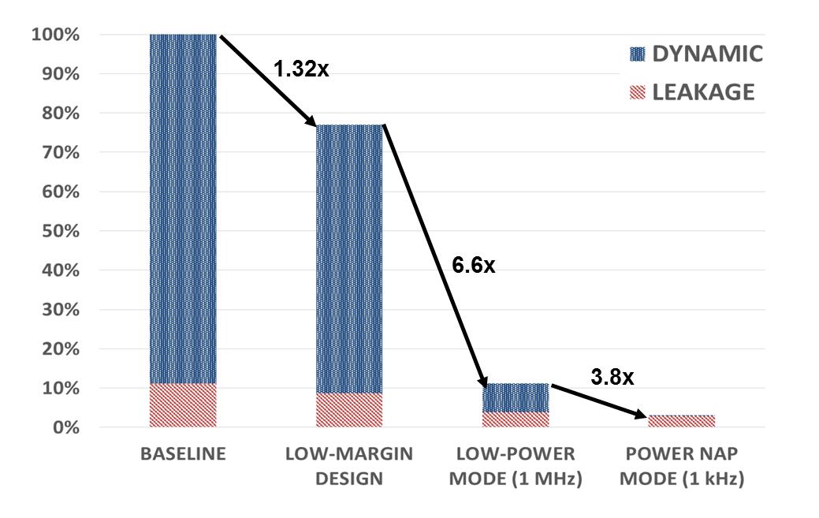
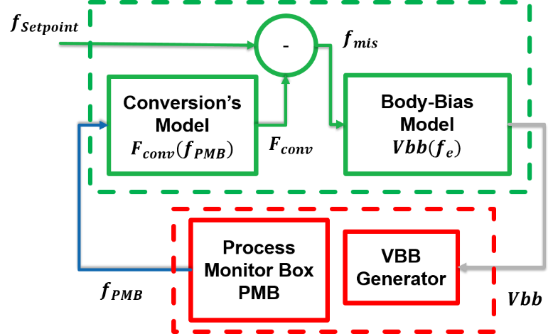
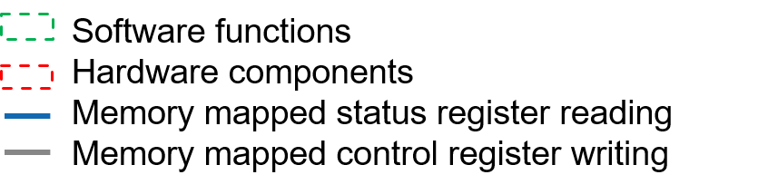



Body Bias-Based Performance Monitoring and Control
→ Mixed Hardware/Software control loop exploiting on-chip frequency measurement (PMB)
Goal:
Compensate the effects of external factors like ambient temperature
Reduce PVT Margings at design time
Improve Energy Efficiency
D. Rossi et al., "A Self-Aware Architecture for PVT Compensation and Power Nap in Near Threshold Processors,"
in IEEE Design & Test, Dec. 2017.

Slide 17
Extending RISC-V for NSP
<32-bit precision → SIMD2/4 opportunity
            HW loops and Post modified LD/ST
            Bit manipulations
            Packed-SIMD ALU operations with dot product
            Rounding and Normalizazion
            Shuffle operations for vectors
RISC-V → V1
V1
Baseline RISC-V RV32IMC
HW loops
Post modified Load/Store
Mac
V2
V2
V3
V3
SIMD 2/4 + DotProduct + Shuffling
Bit manipulation unit
Lightweight fixed point
Small Power and Area overhead
M. Gautschi et al., "Near-Threshold RISC-V Core With DSP Extensions for Scalable IoT Endpoint Devices," in IEEE TVLSI, Oct. 2017.

Slide 18
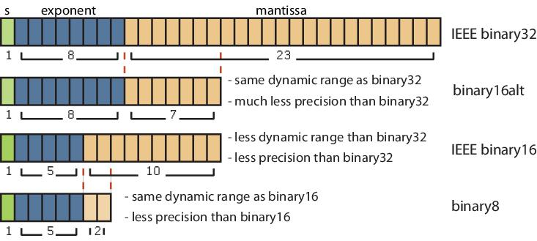
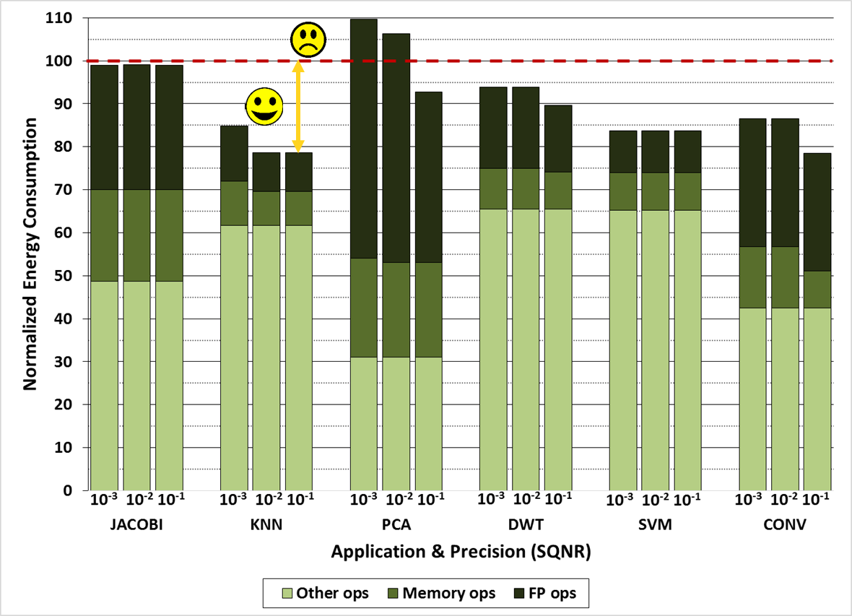
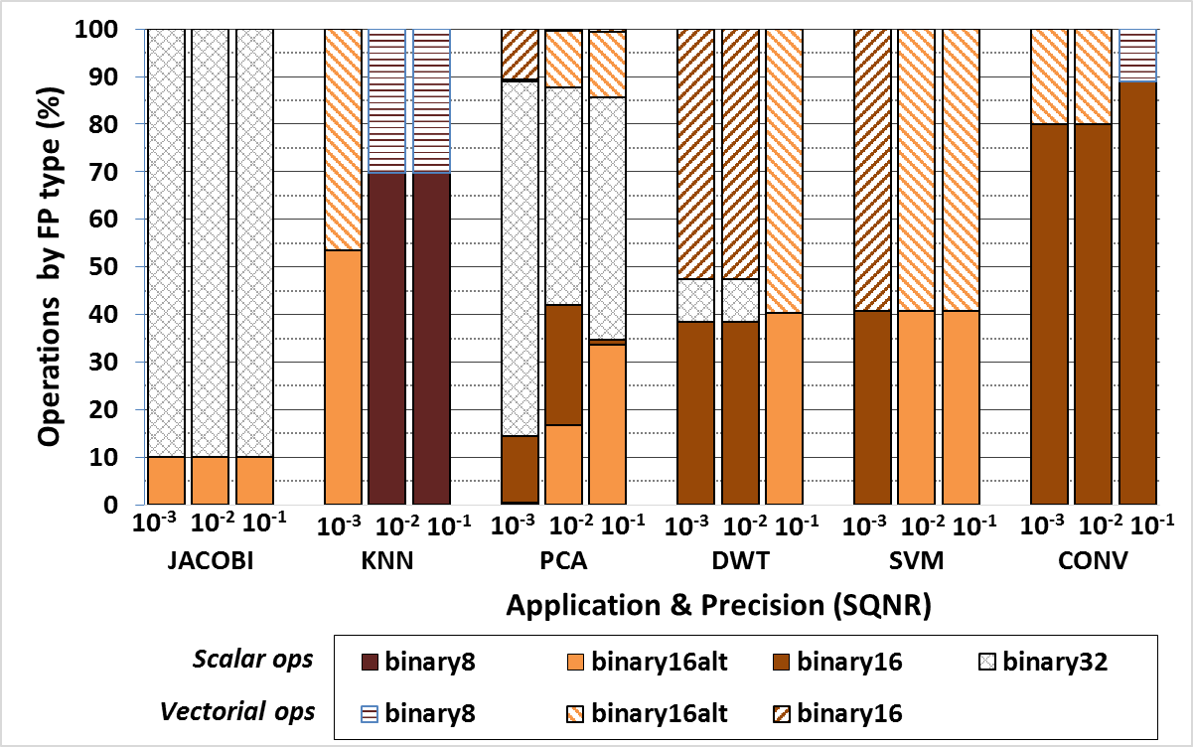
What About FP?
The adoption of floating point formats requiring a lower number of bits (smallFloats) can reduce execution time and energy consumption
  Simpler Logic (smaller pj/op)
  Vectorization (smaller execution time)
SW support:
  flexFloat library for emulation of smallFloat format
  Automatic exploration tool to tune precision of individual FP operations for the required application accuracy
Hardware support:
  smallFloat scalar and vector operations
  Casting operations to move data through different FP types
Tagliavini et. A.l, «A Transprecision Floating-Point Platform
for Ultra-Low Power Computing», DATE 2018

Slide 19
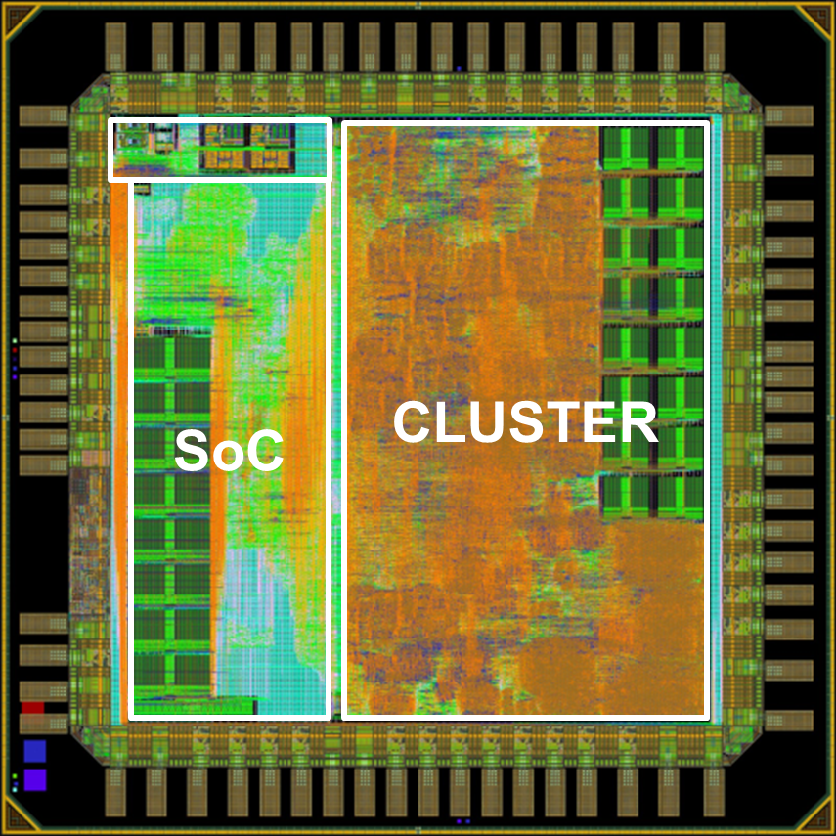
The Evolution of the ‘Species’
 | PULPv1 | PULPv2 | PULPv3
# of cores | 4 | 4 | 4
L2 memory | 16 kB | 64 kB | 128 kB
TCDM | 16kB SRAM | 32kB SRAM 8kB SCM | 32kB SRAM 16kB SCM
DVFS | no | yes | yes
I$ | 4kB SRAM private | 4kB SCM private | 4kB SCM shared
DSP Extensions | no | no | yes
HW Synchronizer | no | no | yes
 | PULPv1 | PULPv2 | PULPv3
Status | silicon proven | Silicon proven | post tape out
Technology | FD-SOI 28nm conventional-well | FD-SOI 28nm flip-well | FD-SOI 28nm conventional-well
Voltage range | 0.45V - 1.2V | 0.3V - 1.2V | 0.5V - 0.7V
BB range | -1.8V - 0.9V | 0.0V - 1.8V | -1.8V - 0.9V
Max freq. | 475 MHz | 1 GHz | 200 MHz
Max perf. | 1.9 GOPS | 4 GOPS | 1.8 GOPS
Peak en. eff. | 60 GOPS/W | 135 GOPS/W | 385 GOPS/W
2.6pj/OP

Slide 20
Outline
Near Threshold Multiprocessing
Non-Von Neumann Accelerators
Aggressive Approximation
From Frame-based to Event-based Processing
Outlook and Conclusion

Slide 21
Recovering More Silicon Efficiency
GOPS/W
1
3
6
> 100
SW
Mixed
HW
<1 pj/OP
General-purpose
Computing
Throughput
Computing
ULP parallel
Computing
CPU
GPGPU
Accelerator Gap
HW IP
Closing The Accelerator Efficiency Gap with Agile Customization

Slide 22
Heterogeneous PULP Cluster
Fixed function accelerators have limited reuse… how to limit proliferation?

Slide 23
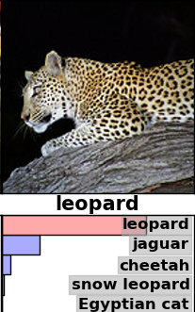
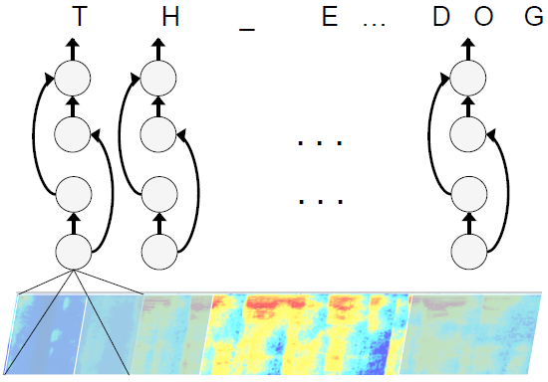
Learn to Accelerate
Brain-inspired (deep convolutional networks) systems are high performers in many tasks over many domains
Human:
85% (untrained),
94.9% (trained)
CNN:
93.4% accuracy
Image recognition
[RussakovskyIMAGENET2014]
Speech recognition
[HannunARXIV2014]
Flexible acceleration: learned CNN weights are “the program”

Slide 24
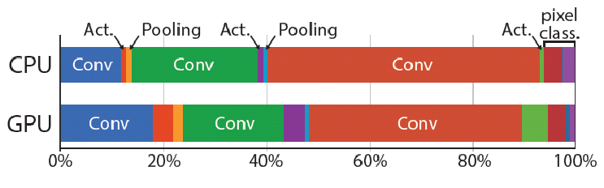
Computational Effort
Computational effort
  10-class scene labeling on Stanford-BG
  7.5 GOp/frame for 320x240 image (#Op=2 × #MAC)
  260 GOp/frame for FHD
  1050 GOp/frame for 4k UHD
~90% workload is Conv
24
What about pooling/FC layers?
Origami CNN ASIC
L. Cavigelli et. Al., "Origami: A 803-GOp/s/W Convolutional Network Accelerator," in IEEE TCSVT, Nov. 2017.

Slide 25
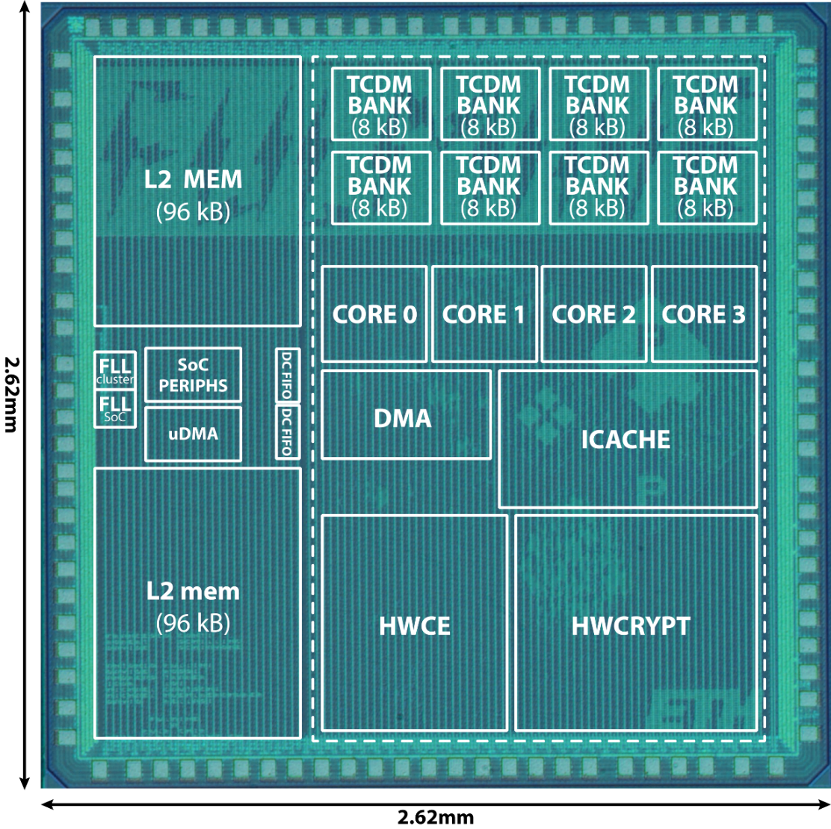
Heterogeneous PULP SoC: Fulmine
Fulmine: Hardware Convolutional Engine (HWCE) in the Cluster
~6.9 mm2 PULP chip, 1/2016
4 cores
1 HWCRYPT accelerator
1 HWCE for 3D conv layers
64kB L1, 192kB L2
QSPI (M/S), I2C, I2S, UART
~1514 kGE for the cluster
232 kGE for the CNN HWCE
SHARED-MEM IF
Line Buffer +
Scalable Precision SOP
CTRL
Crypto Engine → Secure Analytics
F. Conti et al., "An IoT Endpoint System-on-Chip for Secure and Energy-Efficient Near-Sensor Analytics,",in IEEE TCAS-I Sept. 2017.

Slide 26
Heterogeneous PULP CNN Performance
Cluster performance and energy efficiency on a 64x64 CNN layer (5x5 conv)
PERFORMANCE
ENERGY EFFICIENCY
3250 GOPS/W
13 GOPS
84x
5x
218x
[Mop/s]
[Mop/s/W]
Scaled to ST FD-SOI 28nm @ Vdd=0.6V, f=115MHz
0.3 pj/OP
Notes:
Pulp v3 comes out of the blue here – it’s important to introduce it before – see my previous note

Slide 27
Outline
Near Threshold Multiprocessing
Non-Von Neumann Accelerators
Aggressive Approximation
From Frame-based to Event-based Processing
Outlook and Conclusion

Slide 28
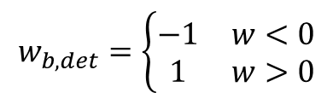
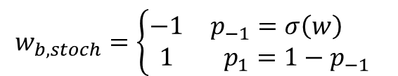
Pushing Further: YodaNN¹
Approximation at the algorithmic side →Binary weights
BinaryConnect [Courbariaux, NIPS15], XOR NET [Rastegari, arXiv16]
  Reduce weights to a binary value -1/+1
  Stochastic Gradient Descent with Binarization in the Forward Path
  Learning large networks is still challenging, but starts to become feasible:
  ResNet-18 on ImageNet with 83.0% (binary-weight) vs. 89.2% (single- precision) top-5 accuracy; and 60.8% vs. 69.3% top-1 accuracy
Ultra-optimized HW is possible!
  Major arithmetic density improvements: MAC → 2s compl. & Accum.
    Area can be used for more energy-efficient weight storage
  Storage reduction → SCM memories for lower voltage → E goes with 1/V²
$$w_{b, stoch}=\left\{\begin{matrix}−1 & p_{−1}=σ\left(w\right) \\ 1 & p_{1}=1−p_{−1}\end{matrix}\right.$$
$$w_{b,det}=\left\{\begin{matrix}−1 & w<0 \\ 1 & w>0\end{matrix}\right.$$
¹After the Yedi Master from Star Wars - “Small in size but wise and powerful” cit. www.starwars.com

Slide 29
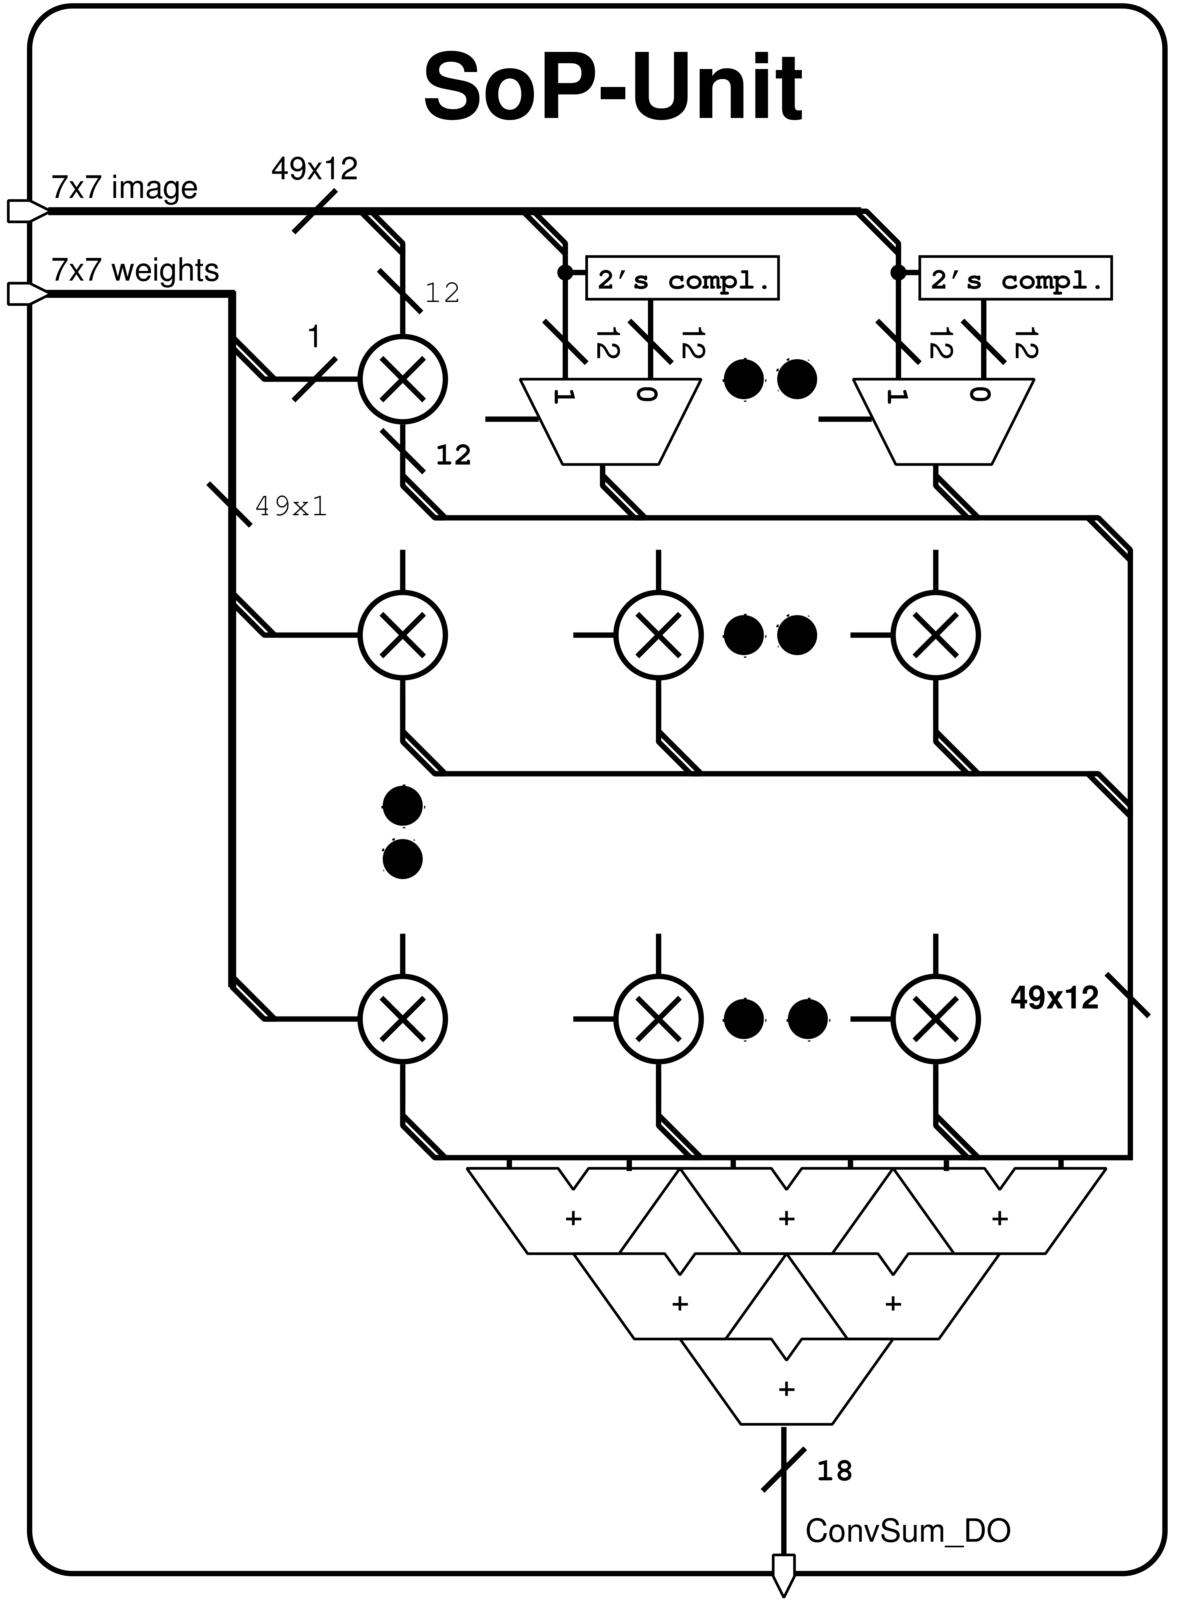
SoP-Unit Optimization
ImageBank
FilterBank
Image Mapping (3x3, 5x5, 7x7)
Equivalent for 7x7 SoP
1 MAC Op = 2 Op (1 Op for the “sign-reverse”, 1 Op for the add).

Slide 30
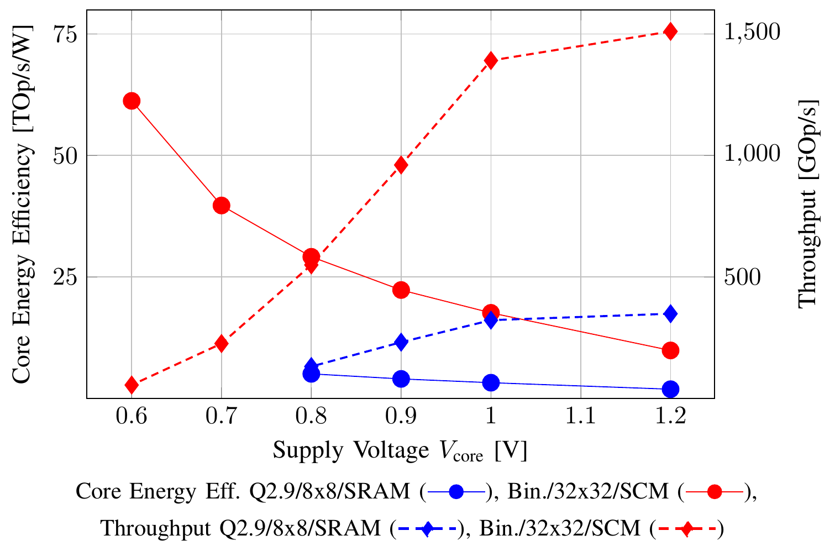
YodaNN Energy Efficiency
Same area 8→32 SoP units + all SCM
0.03pj/OP
12x Boost in core energy efficiency (single layer)
R. Andri et. al., "YodaNN: An Architecture for Ultra-Low Power Binary-Weight CNN Acceleration," in IEEE TCAD, In Press.

Slide 31

Origami, YodaNN vs. Human
The «energy-efficient AI» challenge (e.g. Human vs. IBM Watson)
Type | Analog (bio) | Q2.9 Precision | Q2.9 Precision | Binary-Weight
Network | human | ResNet-34 | ResNet-18 | ResNet-18
Top-1 error [%] |  | 21.53 | 30.7 | 39.2
Top-5 error [%] | 5.1 | 5.6 | 10.8 | 17.0
Hardware | Brain | Origami | Origami | YodaNN
Energy-eff. [uJ/img] | 100.000(*) | 1086 | 543 | 31
*P_{brain} = 10W, 10% of the brain used for vision, trained human @ 10img/sec
Game over for humans also in energy-efficient vision?
Not yet!
  Numbers above assume on-chip storage (1MB binary weights)
  Object recognition is a very basic task!

Slide 32
Outline
Near Threshold Multiprocessing
Non-Von Neumann Accelerators
Aggressive Approximation
From Frame-based to Event-based Processing
Outlook and Conclusion

Slide 33



Back to System-Level
Smart Visual Sensor→ idle most of the time (nothing interesting to see)
Event-Driven Computation, which occurs only when relevant events are detected by the sensor
Event-based sensor interface to minimize IO energy (vs. Frame-based inteface
Mixed-signal event triggering with an ULP imager with internal processing AMS capability
PULPv3
GrainCam
Mixed-Signal Event-based Imager
Digital Parallel Processor
A Neuromorphic Approach for doing nothing VERY well

Slide 34
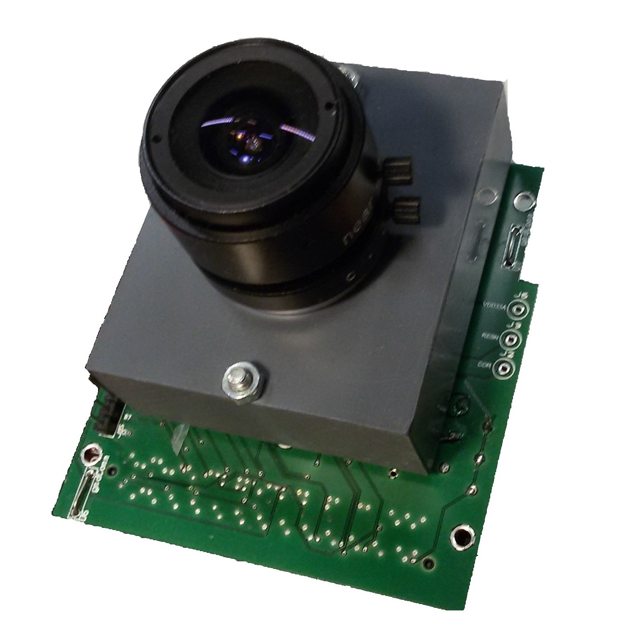
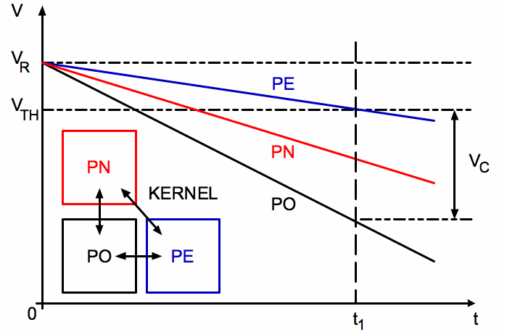

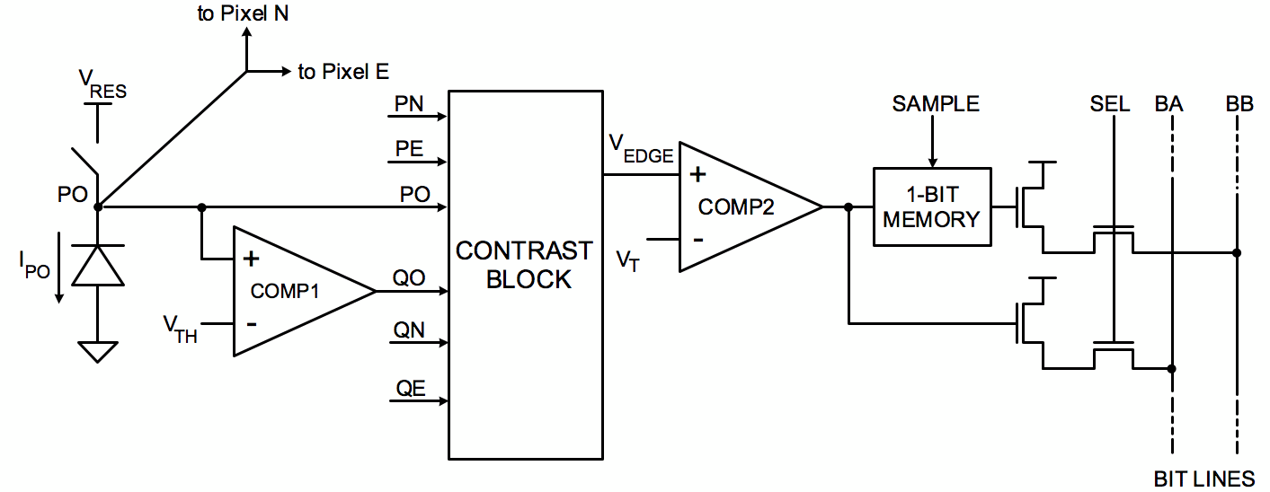
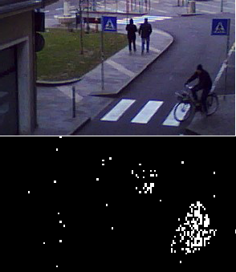
GrainCam Imager (FBK)
Pixel-level spatial-contrast extraction
Analog internal image processing
Contrast Extraction
Motion Extraction, differencing two successive frames
Background Subtraction, differencing the reference image, stored in the memory, with the current frame

Slide 35
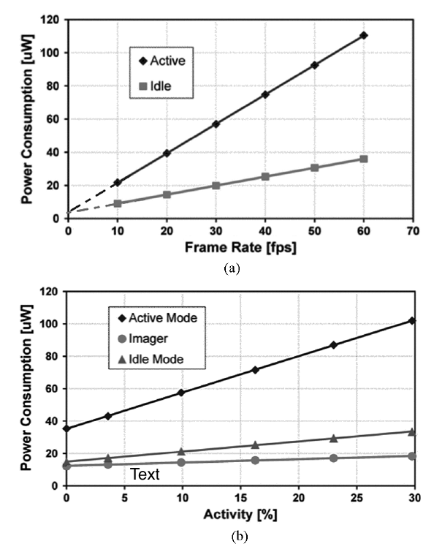


GrainCam Readout
Readout modes:
  IDLE: readout the counter of asserted pixels
  ACTIVE: sending out the addresses of asserted pixels (address-coded representation), according raster scan order
Event-based sensing: output frame data bandwidth depends on the external context-activity
{x₀, y₀}
Frame-based
{x₁, y₁}
Event-based
{x₂, y₂}
{x₃, y₃}
{x_{N-1}, y_{N-1}}
Ultra Low Power Consumption e.g. 10-20uW @10fps

Slide 36
Power Management
PULP
Graincam
#events > threshold
Switch to ACTIVE
Wake-up
event
Data
event
Graincam
IDLE
ACTIVE
READOUT
10μW @10fps
10-20μW @10fps
PULP
Deep Sleep
Deep Sleep
Data Trasfer
Processing
7μW
2.88 mW Active Power @ 0.55V , 81MHz
M. Rusci, et. al., "A Sub-mW IoT-Endnode for Always-On Visual Monitoring and Smart Triggering," in IEEE IoT Journal, 2017.

Slide 37
Event-Driven Binary Deep Network
Interger Input Layer
Layers with binary inputs and binary weights
Imager
Digital pixel sampling
Output Layer
Integer data
Binary Neural Network (BNN)
Binary Input Layer
Output Layer
binary data (events)
Event-based
Binarized Neural Network
Spatial-local filtering and binarization
Mixed-Signal Sensing
Digital Signal Processing

Slide 38
Preliminary Results
3 Classes:
  Pedestrians
  Bikes
  Cars
84.6% vs. 81.6% Accuracy
300 – 800 µW

Slide 39
Outline
Near Threshold Multiprocessing
Non-Von Neumann Accelerators
Aggressive Approximation
From Frame-based to Event-based Processing
Outlook and Conclusion

Slide 40










PULP: Parallel Computing For The IoT
Programming Model
Virtualization Layer
Compiler Infrastructure
Processor & Hardware IPs
Low-Power Silicon Technology
The output of our research on PULP is open source
(Solderpad License)

Slide 41
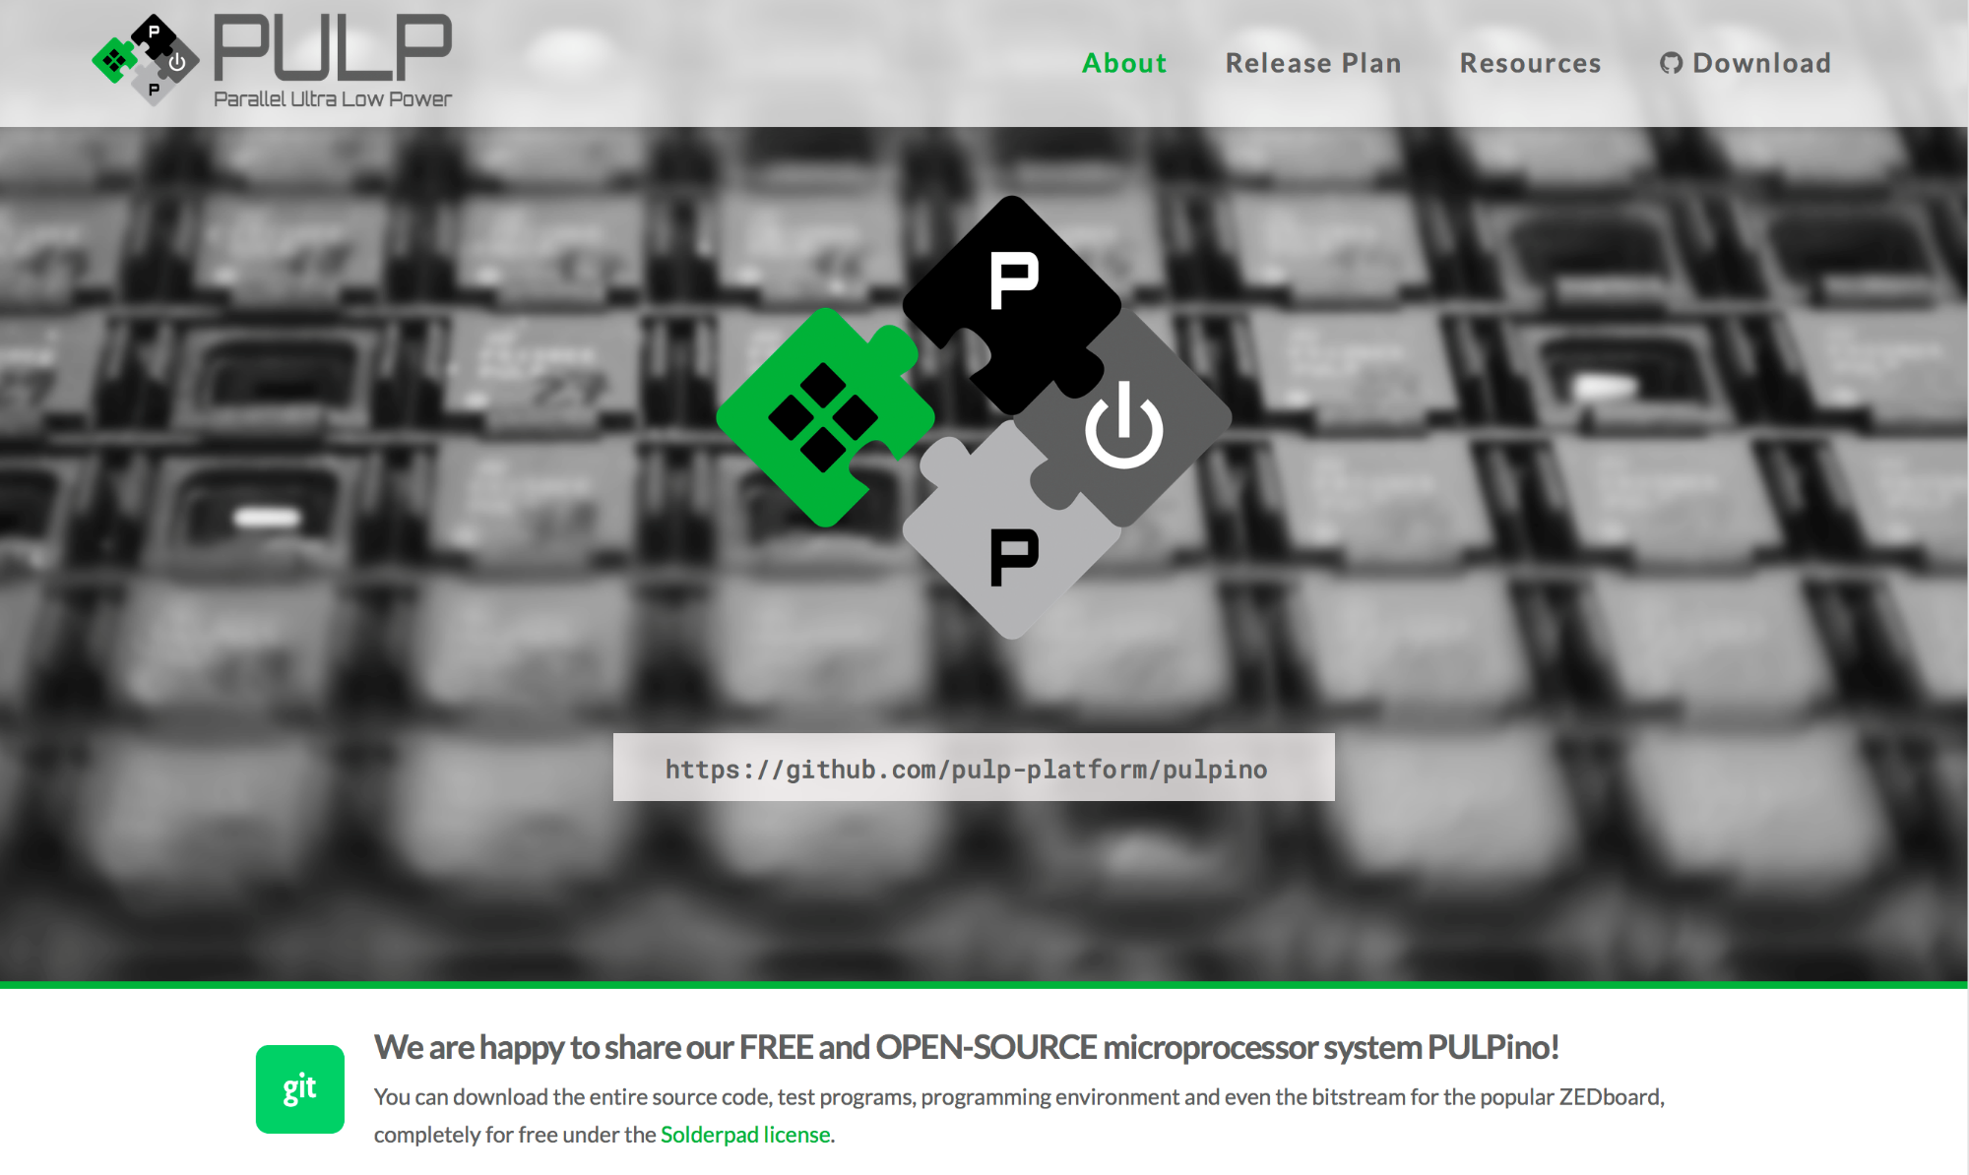
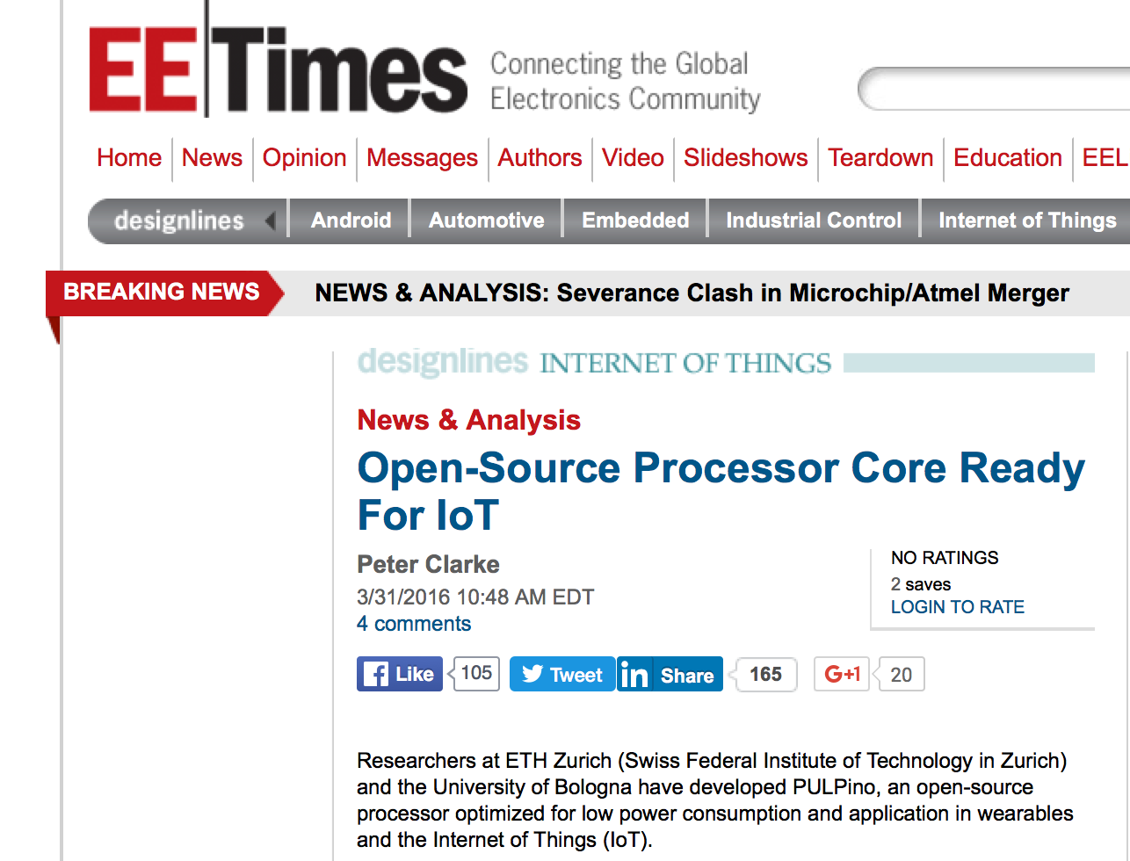
UNIBO and ETHZ Released PULPino
PULPissimo will be released in few weeks!

Slide 42









PULP Users And Collaborations
C
U
10+ COMPANIES
7 UNIVERSITIES
...they are growing
…and growing
RELEASED
TO BE RELEASED
0%
10%
100%

Slide 43
Conclusion
Near-sensor processing → Energy efficiency requirements: pJ/OP and below
  Technology scaling alone is not doing the job for us
  Ultra-low power architecture and circuits are needed
CNNs-based visual functions can be squeezed into mW envelope
  Non-von-Neumann acceleration
  Very robust to low precision computations (deterministic and statistical)
  fJ/OP is in sight!
More than CNN is needed (e.g. linear algebra, online optimizazion)
Open Source HW & SW approach →innovation ecosystem

Slide 44
Thanks for your attention!!!
www.pulp-platform.org
The fun is just at the beginning...

