Slide 1
Runtime-Guided Management of Multicore Cache Hierarchies
Per Stenström
Chalmers University of Technology
Sweden

Slide 2
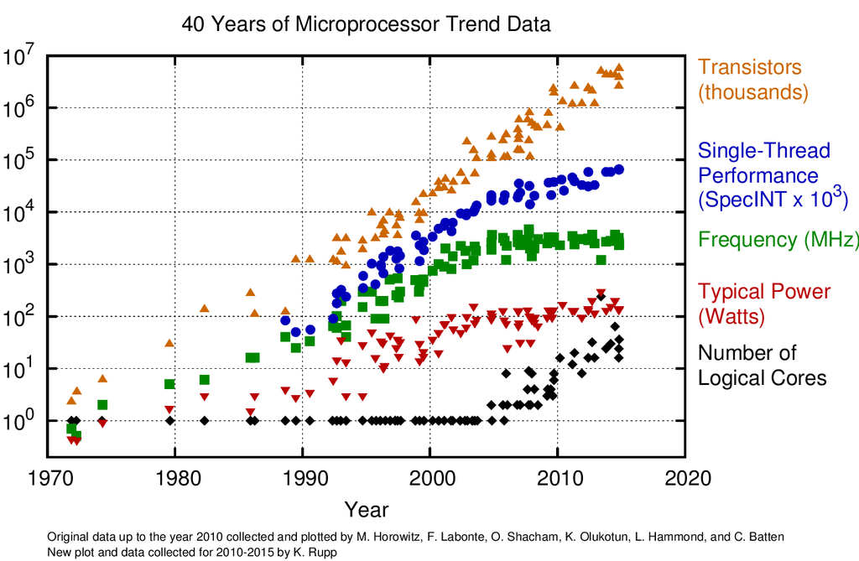
Scaling (as we know it) is ending soon…
A radical new way of how we think about
compute efficiency is needed

Slide 3
Slide for Beginners
Problem
Algorithm
Program
ISA
Microarchitecture
Circuits
Electrons

Slide 4
Need to Put the Stake in the Ground
Problem
Algorithm
Program
ISA
Microarchitecture
Circuits
Electrons

Slide 5
MECCAs Approach – Interaction Across Layers
Parallel programming model plus semantic information
ISA + primitives
Resource Management
Microarchitecture

Slide 6
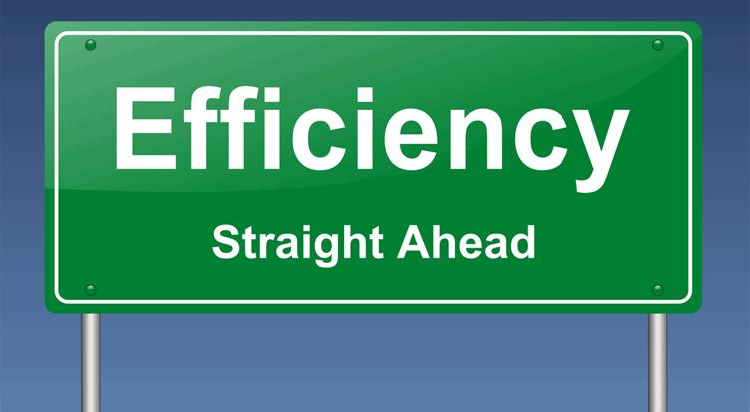
MECCA’s Vision for Efficient Computing
P1: Parallelism:
Programmers: Unlock parallelism and provide semantic information
Resource manager (runtime): Manage parallelism “under the hood”
P2: Power:
Programmers: Express quality of service attributes
Resource manager (runtime): Translate them into efficient use of hardware resources “under the hood”
P3: Predictability:
Programmers: Express quality of service attributes
Resource manager (runtime): Manage parallelism predictably to meet timing constraints “under the hood”

Slide 7
Parallelism Management

Slide 8
Task-based Dataflow Prog. Models
#pragma css task output(a)
void TaskA( float a[M][M]);
#pragma css task input(a)
void TaskB( float a[M][M]);
#pragma css task input(a)
void TaskC( float a[M][M]);
TaskA
TaskB
TaskC
Programmer annotations for task dependences
Annotations used by runtime system for scheduling
Dataflow task graph constructed dynamically
Convey semantic information to runtime for efficient scheduling
Notes:
Introduce StarSS like models: programming perspective and run-time perspective. Opportunities and state of the art.

Slide 9
Runtime Management of Cache Hierarchy
View: Runtime is part of the chip and responsible for management of the cache hierarchy
- in analogy with OS managing virtual memory
Runtime assisted cache management:
Runtime-assisted cache coherence optimizations
Runtime-assisted dead-block management
Runtime-assisted global cache management

Slide 10
Runtime-Assisted Coherence Management [Manivannan and Stenstrom IPDPS 2014]

Slide 11
Vision
Dependency annotations allow for optimizations with high accuracy (like in message passing)
Output
A[…]
Input
A[…]
Bulk data transfer
Prod
Cons
Output
A[…]
Input
A[…]
Prod
Cons
Forwarding
Output
A[…]
Input
A[…]
Prod
Cons
Prefetching
Inout
A[…]
Inout
A[…]
Migratory sharing
optimization
T1
T2

Slide 12
Baseline System
Dir
L3
Dir
L3
Dir
L3
On-chip interconnect
Private
L1/L2 Cache
Private
L1/L2 Cache
Private
L1/L2 Cache
P
P
P
Coherence is maintained by a directory-based MESI protocol

Slide 13
Producer-Consumer Sharing 1(2)
Dir
L3
Dir
L3
Dir
L3
Upgrade
Private
L1/L2 Cache
Private
L1/L2 Cache
Private
L1/L2 Cache
P
P
P
Producer must get ownership of data before modifying it
Upgrade happens block-by-block

Slide 14
Producer-Consumer Sharing 2(2)
Dir
L3
Dir
L3
Dir
L3
Downgrade
Private
L1/L2 Cache
Private
L1/L2 Cache
Private
L1/L2 Cache
P
P
P
Consumer must remotely read from producer’s cache
Optimization: Producer downgrade blocks

Slide 15
Migratory Sharing 1(2)
Dir
L3
Dir
L3
Dir
L3
Upgrade
Private
L1/L2 Cache
Private
L1/L2 Cache
Private
L1/L2 Cache
P
P
P
Producer must get ownership of data before modifying it
Upgrade happens block-by-block

Slide 16
Migratory sharing 2(2)
Dir
L3
Dir
L3
Dir
L3
Downgrade
And
Self-invalidate
Private
L1/L2 Cache
Private
L1/L2 Cache
Private
L1/L2 Cache
P
P
P
Current node must remotely read exclusively from previous node
Optimization: Self-invalidate and downgrade blocks

Slide 17
Runtime Triggered Prefetching
Dir
L3
Dir
L3
Dir
L3
Prefetching
Private
L1/L2 Cache
Private
L1/L2 Cache
Private
L1/L2 Cache
P
P
P
Prefetching is helpful to hide LLC access latency both for producer/consumer and migratory sharing

Slide 18
Runtime System Support
Runtime uses dependency information to trigger coherence optimizations and prefetching of data structures

Slide 19
Experimental Methodology

Slide 20
Sharing Characteristics
Cholesky Matmul Qr SparseLu
Cholesky Matmul Qr SparseLu
MC
MG
OT
Remote
Upgrade
LLC shar
LLC priv
The following dominate behavior:
Migratory sharing
Remote access, upgrades and LLC access

Slide 21
Impact on Memory Stall Time
LLC priv
LLC sha
Upgrade
Remote
BL D SI D+SI SP SP+D+SI
BL D SI D+SI SP SP+D+SI
BL D SI D+SI SP SP+D+SI
BL D SI D+SI SP SP+D+SI

Slide 22
Runtime-Assisted Dead-Block Management [Manivannan et al. HPCA 2016]

Slide 23
Motivation
Most of the blocks in LLCs are dead and consume precious cache space
State-of-the-art schemes predict dead-blocks without any semantic information from the programming model
RADAR’s approach: Use static information from parallel programming models to accurately detect and eliminate dead blocks

Slide 24
Overview of RADAR
Specify Task and its Region Accesses
Is Region dead
after current access?
Evict (demote to LRU)
region from LLC
Three schemes:
Look Ahead (LA): Use data-dependce graph for prediction
Look Back (LB): Use past region access statistics
Combined: LA ∩ LB and LA∪LB

Slide 25
Look Ahead Scheme
A00 is reused by T1-T4
When T1-T4 are done, A00 can be deemed dead
A22 is accessed by T8, T12, T13 and will not be deemed dead
Look Ahead does not take size of regions into account
Look Ahead only accounts for a limited outlook

Slide 26
Look Back Scheme
Leverages that region accesses are predictable.
Region miss = all blocks in that region will miss
Approach: use branch prediction to predict future region hits/misses.
Predict region MISS: demote all blocks to the region
Predict region HIT: keep region in the cache

Slide 27
Combined Scheme
By default, all region accesses are classified as hits
LA
LB
LA: Set of predicted region misses under LA
LB: Set of predicted region misses under LB
Combined (conservative): LA ∩ LB
Combined (aggressive): LA∪LB

Slide 28
Experimental Methodology

Slide 29
Miss Rate Improvements
Look-Ahead consistently does better than Look-back
RADAR-Combined provides additional gains

Slide 30
Exec. Time Improvements
Memory bound apps provide significant gains

Slide 31
Miss Reduction: SHIP vs RADAR
SHiP-PC
2-bit SRRIP
16K SHCT
SHiP can evict data from LLCs prematurely
RADAR outperforms the best performing predictor

Slide 32
Concluding Remarks
Parallel programming model plus semantic information
ISA + primitives
Resource Management
Microarchitecture
MECCA team members:
Nadja Holtryd, Madhavan Manivannan, Mehrzad Nejat, Vasileios Papaefstathiou,
Risat Pathan, Miquel Pericàs, Per Stenstrom, Mohammad Waqar, Petros Voudouris

Slide 33
?

